Slide 1
CompTIA Security +

Slide 2
Domain 05: Security Program Management and oversight

Slide 3

Implement the elements of effective security governance to enhance organizational security protocols
Apply elements of the Risk Management Process to mitigate potential risks effectively
Execute the processes associated with third-party risk assessment and management to ensure comprehensive security coverage
Integrate the importance of effective security compliance to maintain regulatory standards
Utilize types and purposes of audits and assessments to improve overall security measures
Notes:
Trainer Notes:
Summarize the points given on the slide and set an expectation about learning these pointers in this lesson.

Slide 4
Security Policy, Standards, Procedures, and Guidelines

Slide 5
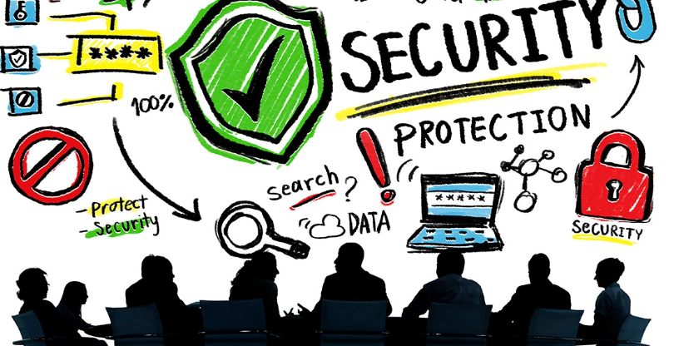
Security Management Plan
It is a set of structured Standard Operating Procedures (SOPs) specifically designed to help you achieve these goals.
It provides guidelines, regulations, standards, options and hierarchical structure, as well as policies, procedures and protocols (PPP’s).
Notes:
Trainer Notes:
Information Security Management:
Information Security Management describes the controls that an organization needs to implement to ensure that it is sensibly protecting the confidentiality, availability, and integrity of assets from threats and vulnerabilities.
It also includes information risk management which is a process that involves the assessment of the risks an organization must deal with in order to manage and protect the assets, as well as the dissemination of other risks to all appropriate stakeholders.
It should be developed after careful assessment and evaluation of org assets and security objectives and goals of an organization.

Slide 6
Security Plan Components
1. Security policies
2. Standards
3. Guidelines
4. Procedures
5. Baselines
6. Org Structure
Top Management is responsible for policies, mid level management is responsible for developing standards, guidelines and procedure in alignment with security policies.
Notes:
Trainer Notes:
Security Plan Components- These components are discussed in details in further slides

Slide 7
Approaches to Security Plan
Top-Down Approach
Bottom-up Approach
Management understands the security and Initiates the policy which is then systematically percolated down to operations staff.
Top-level managers are the ones responsible for initiating, creating, and implementing your data protection strategy, including policy creation, procedural instructions, and escalation plans
This is more successful as compared to bottom-up approach
In this approach, operational staff initiate the process then propagate their findings upward to management as proposed policy recommendations.
This approach has at times sparked a fiasco due to management not fully aware of things.
The main advantage of a bottom-up approach to infosec is that you're using a person or team's experience and expertise to handle intricate security concerns
Notes:
Trainer Notes:
Forensic Disk Controller
A forensic disk controller or a hardware write-block device is a specialized type of computer hard disk controller made for the purpose of gaining read-only access to computer hard drives without the risk of damaging the drive's contents.
The device is named forensic disk controller because its most common application is used in investigations where a computer hard drive may contain evidence.
Functions of a Forensic Disk Controller
A hardware write-block (HWB) device will not transmit a command to a protected storage device that modifies the data on the storage device.
An HWB device will return the data requested by a read operation.
An HWB device will return without modification any access-significant information requested from the drive.
Any error condition reported by the storage device to the HWB device will be reported to the host.

Slide 8
Security Management Plan Types
Strategic plan
Long term plan
Defines with goals of the entire organization with a holistic approach in mind
Effective for at least five years and reviewed annually
Senior Management
Tactical plan
Tactics are means needed to activate a strategy.
A mid-term plan developed to provide more detailed goals
Typically spans one to two year and is technology oriented
Ex: Project plans, acquisition plan, budget plan, hiring plan
Middle Management
Operational plan
Short-term plan with specific results expected from departments and workgroups.
Highly-detailed plan
Must be updated often (monthly, quarterly)
Example: resource allotment, budgetary allocation, and training plans
Implementation Team
Notes:
Strategic Plan:
Long term plan
Defines with goals of entire organization as a whole in mind
Useful for at least 5 years. Reviewed annually
Tactical Plan :
Tactics are means needed to activate a strategy.
Mid-term plan developed to provide more detailed goal
Usually for a year or two and technology oriented
Ex: Project plans, acquisition plan, budget plan, hiring plan
Operational Plan
Short-term plan and specific results expected from dept, workgroups.
Highly-detailed plan
Must be updated often (monthly, quarterly)
Eg: resource allotment, budgetary allocation, training plans

Slide 9
Different Types of Policies

Slide 10
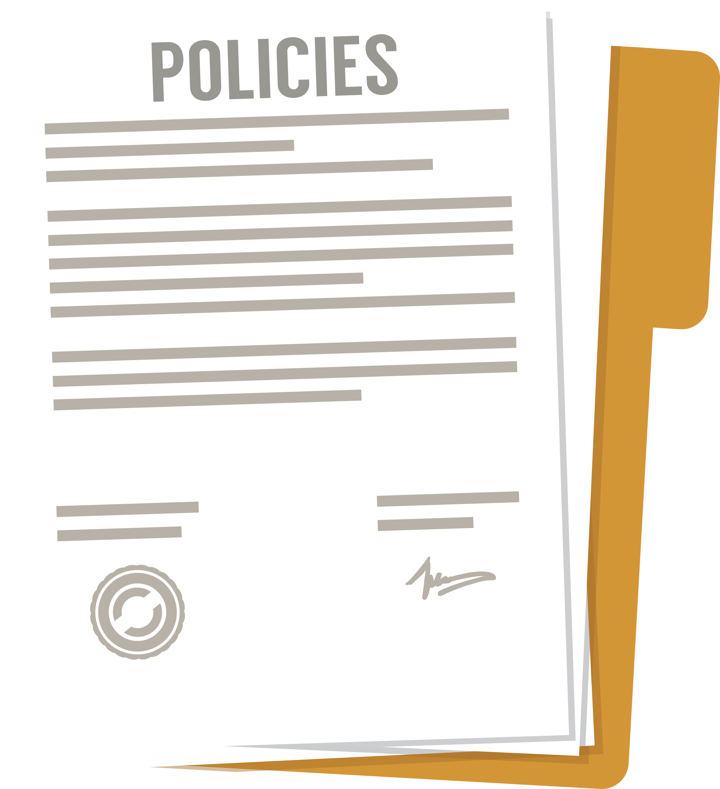
Security Policies
Security policy is a broad statement produced by the senior management that dictates the role of security within the organization.
The characteristics of security policies are:
It must be generic, non-technical, and easily understood.
It must integrate security into all business processes and functions.
It must be reviewed and modified periodically or as the company environment changes.
It must support the vision and mission of the organization.
Notes:
Trainer Notes:
Security policy is a broad statement produced by the senior management that dictates the role of security within the organization.
The characteristics of security policies are:
It must integrate security into all business processes and functions.
It must support the vision and mission of the organization.
It must be reviewed and modified periodically or as the company environment changes.
It must be generic, non-technical, and easily understood.

Slide 11
Types of Security Policies
There are mainly three types of security policies:
Organizational security policy
It focuses on issues relevant to every aspect of the organization.
Issue-specific policy
It focuses on a specific service, department, or function that is distinct from the organization.
System-specific policy
It focuses on individual systems.
Notes:
Trainer Notes:
There are mainly three types of security policies:
Organizational security policy: It focuses on issues relevant to every aspect of the organization.
Issue-specific policy: It focuses on a specific service, department, or function that is distinct from the organization.
System-specific policy: It focuses on individual systems.

Slide 12

Organizational Security Policy
Security policy reduces the likelihood of:
Regulatory and Legal consequences
Financial Losses
Misuse/abuse of system and resources
Irretrievable loss of data
Reputational Damage
Notes:
Trainer Notes:
The goals of incident response are:
Provide management with sufficient information
Maintain or restore business continuity
Defend against future attacks
Deter attacks through investigation and prosecution
Reduce the potential impact to the organization

Slide 13
Policy Chart
A strategic goal can be viewed as the ultimate endpoint, while tactical goals are the steps necessary to achieve it.
Laws, regulations, and requirements
General organizational policy
Functional implementation policies
Standards
Baselines
Guidelines
Procedure
Notes:
Trainer Notes:
A strategic goal can be viewed as the ultimate endpoint, while tactical goals are the steps necessary to achieve it.
Explain the diagram given on the screen.

Slide 14









Different Types of Policies
Information security policy
Acceptable use policy
Business continuity policy
Incident response policy
Software development lifecycle policy
Change management policy
Disaster recover policy
Notes:
Trainer Notes:
Different types of Policies
Information Security policies
Acceptable Use Policies
Business Continuity Policy
Incident Response Policy
Disaster Recovery Policy
Software Development lifecycle policy
Change Management policy

Slide 15

Information Security Policy (ISP)
It is a document that outlines an organization's plan for protecting its information assets. It also covers various topics, from data classification and encryption to network security protocols.
Information security policies outline the guidelines and procedures for protecting the organization’s data and technology assets.
Notes:
Trainer Notes:
An information security policy (ISP) is a document that outlines an organization's plan for protecting its information assets.
Information security policies outline the guidelines and procedures for protecting the organization’s data and technology assets.
It covers various topics, from data classification and encryption to network security protocols.

Slide 16
Examples of Information Security Policy
Policy Name | Description | Example Requirements
Data classification policy | Defines how data is categorized based on sensitivity. | All sensitive customer data must be labeled confidential and encrypted.
Access control policy | Specifies who can access what resources and under what conditions. | Two-factor authentication is required for accessing any financial systems.
Network security policy | Outlines the configurations and security measures for network devices and infrastructure. | Firewalls must be configured to block all incoming traffic that is not explicitly required for business.
Endpoint security policy | Sets the security standards for individual devices like computers, smartphones, and tablets. | All endpoints must have updated antivirus software installed.
Encryption policy | Details the methods and protocols for encrypting data at rest, in transit, and during processing. | AES-256 encryption must be used for all data at rest.
Notes:
Explain the policies mentioned in slide

Slide 17
Examples of Information Security Policy
Policy Name | Description | Example Requirements
Incident response policy | Describes the steps to take when a security incident occurs. | Incidents must be reported to the security team within 30 minutes of discovery.
Remote work policy | Sets the rules for employees who work outside the office. | VPNs must be used when accessing company resources remotely.
Password policy | Specifies the requirements for creating, managing, and storing passwords. | Passwords must be at least 12 characters long and include a mix of letters, numbers, and symbols.
Software update policy | Governs how software updates and patches are managed. | Critical security patches must be applied within 48 hours of release.
Compliance policy | Ensures that the organization meets all legal and regulatory requirements. | Regular audits must be conducted to ensure compliance with GDPR.
Notes:
Explain the policies mentioned in slide

Slide 18

Acceptable Use Policy (AUP)
It defines the rules restricting how a computer, network, or other system may be used.
It states what users are and are not allowed to do with an organization's technology infrastructure.
Notes:
Trainer Notes:
An acceptable use policy (AUP) defines the rules restricting how a computer, network, or other system may be used.
It states what users are and are not allowed to do with an organisation's technology infrastructure.
Employees must often sign an AUP before they begin working on any systems.
This policy protects the organization and defines for employees precisely what they should and should not be working on

Slide 19

Business Continuity Policy (BCP)
It is the foundation for an organization's resilience in disruptions.
It outlines the framework for ensuring critical business functions can continue operating even after a disaster or incident.
Notes:
Trainer Notes:
A business continuity policy (BCP) is the foundation for an organization's resilience in disruptions.
It outlines the framework for ensuring critical business functions can continue operating even after a disaster or incident. It helps in minimizing downtime and revenue loss during disruptions.
It helps in minimizing downtime and revenue loss during disruptions.

Slide 20

Disaster Recovery Policy (DRP)
It is a subset of a business continuity plan focusing on restoring IT infrastructure and operations after a crisis.
It details procedures for data recovery, system restoration, and other necessary technical steps to resume normal operations.
Notes:
Trainer Notes:
A disaster recovery policy is a subset of a business continuity plan that focuses on restoring IT infrastructure and operations after a crisis. It details procedures for data recovery, system restoration, and other necessary technical steps to resume normal operations. For example, it might specify the use of off-site data storage and define the roles and responsibilities of the disaster recovery team.
A business continuity policy (BCP) is the foundation for an organization's resilience in disruptions.
It outlines the framework for ensuring critical business functions can continue operating even after a disaster or incident. It helps in minimizing downtime and revenue loss during disruptions.
For example, it might specify the use of off-site data storage and define the roles and responsibilities of the disaster recovery team.

Slide 21

Incident Response Policy (IRP)
This specifies the procedures to follow in the event of a cybersecurity incident and include steps for eradication and containment.
It outlines steps for identifying, reporting, and mitigating security breaches.
Notes:
Trainer Notes:
An incident response policy provides guidelines for addressing cybersecurity incidents effectively.
It outlines steps for identifying, reporting, and mitigating security breaches.
These policies specify procedures to follow in the event of a cybersecurity incident and include steps for eradication and containment.
A disaster recovery policy is a subset of a business continuity plan that focuses on restoring IT infrastructure and operations after a crisis. It details procedures for data recovery, system restoration, and other necessary technical steps to resume normal operations. For example, it might specify the use of off-site data storage and define the roles and responsibilities of the disaster recovery team.
A business continuity policy (BCP) is the foundation for an organization's resilience in disruptions.
It outlines the framework for ensuring critical business functions can continue operating even after a disaster or incident. It helps in minimizing downtime and revenue loss during disruptions.

Slide 22

Software Development Lifecycle (SDLC) Policy
This policy governs the entire software development process, from inception to decommissioning.
It includes guidelines for requirements gathering, design, coding, testing, deployment, maintenance, and eventual software retirement.
Notes:
Trainer Notes:
A software development lifecycle (SDLC) policy governs the entire software development process, from inception to decommissioning.
It includes guidelines for requirements gathering, design, coding, testing, deployment, maintenance, and eventual software retirement.
For example, an SDLC policy might require security risk assessment during requirements gathering, code peer reviews for security vulnerabilities, and passing security tests before deployment.

Slide 23

Change Management Policy (CMP)
A change management policy guides how changes to IT systems and processes are proposed, reviewed, and implemented to minimize disruptions and reduce risks. It requires formal approval and post-implementation monitoring to ensure system stability and security. These policies facilitate the adoption of new technologies, processes, or organizational changes, while ensuring alignment with strategic objectives.
Notes:
Trainer Notes:
A change management policy guides how changes to IT systems and processes are proposed, reviewed, and implemented to minimize disruptions and reduce risks. It requires formal approval and post-implementation monitoring to ensure system stability and security. These policies facilitate the adoption of new technologies, processes, or organizational changes, while ensuring alignment with strategic objectives.

Slide 24
Standards

Slide 25

Standards
Standards are established requirements or rules that describe the specific methods and practices to be followed.
The characteristics of security standards are:
Provides detailed guidance beyond policies, explaining how to implement high-level guidelines operationally
Ensures consistent and aligned security practices with industry best practices and regulatory requirements
Requires periodic review and modification or when related policies change
Supports security policies and organizational objectives
Notes:
Trainer Notes:
Standards are established requirements or rules that describe the specific methods and practices to be followed
Characteristics of Standards are
They offer more detailed guidance than policies, explaining how to implement high-level guidelines operationally
Standards ensure consistent and aligned security practices with industry best practices and regulatory requirements.
It must be reviewed and modified periodically or when policy related to standard changes
It must support security policy and objectives of Organization

Slide 26
Password Standard
Password standards are crucial for an organization's access control strategy. They provide guidelines for creating, managing, and safeguarding passwords to prevent unauthorized access.
These standards ensure consistency and interoperability in password management across digital systems.
Notes:
Trainer Notes:
Password standards are the cornerstone of an organization’s access control strategy, setting forth the rules for creating, managing, and storing passwords. Password standards are essential for an effective access control strategy, ensuring that password creation, management, and protection are handled in such a way as to prevent unauthorized access.
Password standards are the architects and custodians of secure access. These standards lay down precise technical requirements for designing and implementing systems, ensuring consistency and interoperability in password management practices across the digital landscape

Slide 27
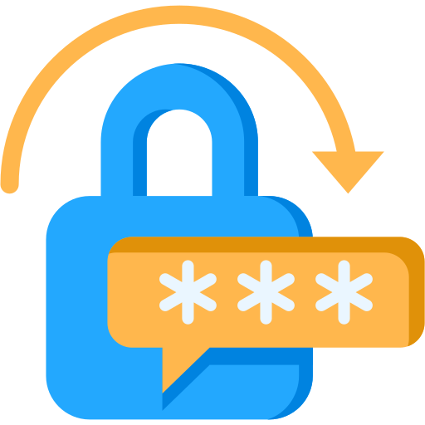



Attributes of Password Standards
Minimum length: CSPs must ensure passwords are a minimum of 12 characters long to enhance security.
Complexity: Passwords must include a mix of characters (e.g., letters, numbers, symbols) to resist attacks.
Expiration: Passwords must be changed at regular intervals. However, NIST SP 800-63B advises against arbitrary periodic changes unless there is a user request or evidence of a breach.
History: To avoid the reuse of potentially compromised credentials, users should not reuse their last 10 passwords.
Notes:
Trainer Notes:
Minimum length: Passwords must be at least 12 characters long to resist attacks.
Complexity: Passwords should include a mix of uppercase and lowercase letters, numbers, and special characters, providing sufficient complexity to resist attacks.
Expiration: Passwords must be changed at regular intervals, though NIST SP 800-63B advises against arbitrary periodic changes unless there is a user request or evidence of a breach.
History: To avoid the reuse of potentially compromised credentials, users should not reuse their last 10 passwords.

Slide 28




Attributes of Password Standards
Lockout policy: Following a series of unsuccessful login attempts, accounts should be temporarily locked to prevent brute-force attacks.
Two-factor authentication: A second verification method should be used along with the password for enhanced security.
Salting: When storing passwords using cryptographic hashes, adding a unique salt to each password prevents attackers from using precomputed tables (rainbow tables) to crack the hashes.
Secure storage: It's best to use a secure password manager to store and manage passwords and avoid insecure practices like writing them down.
Notes:
Trainer Notes:
Lockout Policy: Following a series of unsuccessful login attempts, accounts should be temporarily locked to prevent brute-force attacks.
Two-Factor Authentication: A second verification method should be used along with the password for enhanced security.
Salting: When storing passwords using cryptographic hashes, adding a unique salt to each password prevents attackers from using precomputed tables (rainbow tables) to crack the hashes.
Secure Storage: It's best to use a secure password manager to store and manage passwords and avoid insecure practices like writing them down.
Minimum length: Passwords must be at least 12 characters long to resist attacks.
Complexity: Passwords should include a mix of uppercase and lowercase letters, numbers, and special characters, providing sufficient complexity to resist attacks.
Expiration: Passwords must be changed at regular intervals, though NIST SP 800-63B advises against arbitrary periodic changes unless there is a user request or evidence of a breach.
History: To avoid the reuse of potentially compromised credentials, users should not reuse their last 10 passwords.

Slide 29

Access Control Standard
Defines who can access specific resources within an organization's digital ecosystem
Ensures that only authorized individuals can access specific resources, maintaining data security
Limits the potential for insider and external threats by implementing the principle of least privilege, reducing the attack surface
Notes:
Trainer Notes:
Access control standards are essential for defining who can access what within an organization's digital ecosystem.
They ensure that only authorized individuals can access specific resources, maintaining data security. Implementation of the principle of least privilege limits the potential for insider and external threats, reducing the attack surface.

Slide 30



Attributes of Access Control
Least privilege: Grants users access to only the data, resources, and applications required for their job function
User identity: Uses methods of identification such as usernames, smart cards, or biometrics, based on an organization’s preference
Multifactor authentication: Requires more than one form of authentication for each access request
Privilege access management: Controls administrative accounts within a domain to prevent privilege escalation and enhance security
Notes:
Trainer Notes:
Minimum length: Passwords must be at least 12 characters long to resist attacks.
Complexity: Passwords should include a mix of uppercase and lowercase letters, numbers, and special characters, providing sufficient complexity to resist attacks.
Expiration: Passwords must be changed at regular intervals, though NIST SP 800-63B advises against arbitrary periodic changes unless there is a user request or evidence of a breach.
History: To avoid the reuse of potentially compromised credentials, users should not reuse their last 10 passwords.

Slide 31




Attributes of Access Control Standards
Audit trail: Lists every event that happens on a server and identifies who performed the action and when it occurred
Authentication protocol: Includes SSH keys for Linux, Kerberos in Microsoft environments, OAuth for internet-based authentication, and SAML for third-party authentication
Access control types: Defines how accesses are assigned to subjects or users, such as role-based access control and mandatory access control
Conditional access control: Provides a cloud-based policy that regulates user access to resources, enhancing security and ensuring compliance
Notes:
Trainer Notes:
Audit Trail: Any access control system needs an audit trail that lists every event that happens on a server and identifies who carried out the action and when.
Authentication Protocol: Authentication protocols vary but can include SSH keys for Linux, Kerberos on a Microsoft environment, OAuth for internet-based authentication, and SAML for third-party authentication.
Access Control Types: Defines the way by which accesses are assigned to subjects or users. Ex Role based access control, Mandatory access control etc
Conditional Access Control: A Conditional Access policy is a cloud-based access control that regulates user access to resources, enhancing security and ensuring compliance..
Lockout Policy: Following a series of unsuccessful login attempts, accounts should be temporarily locked to prevent brute-force attacks.
Two-Factor Authentication: A second verification method should be used along with the password for enhanced security.
Salting: When storing passwords using cryptographic hashes, adding a unique salt to each password prevents attackers from using precomputed tables (rainbow tables) to crack the hashes.
Secure Storage: It's best to use a secure password manager to store and manage passwords and avoid insecure practices like writing them down.
Minimum length: Passwords must be at least 12 characters long to resist attacks.
Complexity: Passwords should include a mix of uppercase and lowercase letters, numbers, and special characters, providing sufficient complexity to resist attacks.
Expiration: Passwords must be changed at regular intervals, though NIST SP 800-63B advises against arbitrary periodic changes unless there is a user request or evidence of a breach.
History: To avoid the reuse of potentially compromised credentials, users should not reuse their last 10 passwords.

Slide 32


Physical Security Standard
Physical security standards protect an organization's tangible assets such as buildings, hardware, and personnel.
They are crucial because robust cybersecurity can be compromised by physical access breaches.
Physical security includes secure building access, surveillance systems, and safeguarding hardware.
Effective governance integrates physical security measures into the overall security strategy to prevent severe repercussions of breaches.
Notes:
Trainer Notes:
Physical security standards protect an organization's tangible assets, including buildings, hardware, and personnel.
They are crucial as robust cybersecurity can be rendered ineffective by physical access compromise.
Physical security includes secure building access, surveillance systems, and safeguarding hardware.
Effective security governance integrates physical security measures into the overall security strategy due to the severe repercussions of breaches.

Slide 33

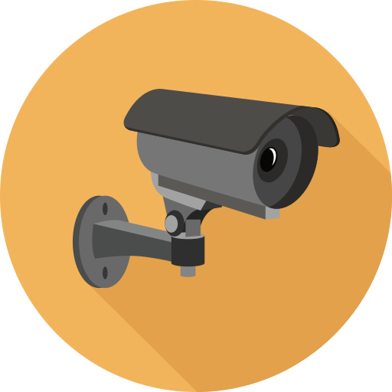

Attributes of Physical Security Standard
Facility access: Specifies who can enter the premises and specific areas using access cards, biometric scans, or staffed security desks
Visitor management: Details procedures for admitting and tracking visitors, such as requiring them to sign in and be escorted by an employee
Surveillance: Monitors and records activity using surveillance equipment, including device placement and footage storage and review
Equipment security: Secures servers, workstations, and other hardware against theft or tampering
Notes:
Trainer Notes:
Facility Access : Guidelines should specify who can enter the premises and specific areas using access cards, biometric scans, or staffed security desks
Visitor Management : An organization should specify procedures for admitting and tracking visitors, perhaps by requiring them to sign in and be escorted by an employee
Surveillance: Surveillance equipment may be used to monitor and record activity. Standards should specify device placement and footage storage and review.
Equipment Security: Measures should be implemented to secure servers, workstations, and other hardware against theft or tampering.

Slide 34



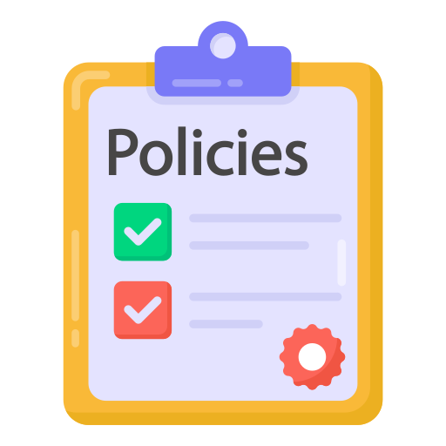
Attributes of Physical Access Control Standard
Environmental control: Installs fire suppression, climate control, and entry alarms to protect hardware and data from environmental risks
Emergency response: Implements guidelines for responding to various emergencies, such as fires, floods, or active shooter situations
Guards: Monitors and safeguards physical premises with trained personnel, providing a visible deterrent and responding to security incidents
Security policies: Provides clear guidelines for staff on password management, visitor access, and reporting suspicious activity
Notes:
Trainer Notes:
Environmental Control: An organization may install fire suppression, climate control, and entry alarms to protect hardware and data from environmental risks.
Emergency Response: An organization may implement guidelines for responding to various emergencies, such as fires, floods, or active shooter situations.
Guards: Trained personnel monitor and safeguard physical premises, providing a visible deterrent and responding to security incidents
Security Policies: Clear guidelines for staff on things like password management, visitor access, and reporting suspicious activity.

Slide 35

Encryption Standard
Ensures data confidentiality and integrity within an organization, both in transit and at rest
Protects against unauthorized access and data breaches, strengthening overall security
Notes:
Trainer Notes:
Encryption standards are crucial for ensuring data confidentiality and integrity within an organization, both in transit and at rest.
Adhering to these standards helps protect against unauthorized access and data breaches, strengthening overall security

Slide 36



Attributes of Encryption Standard
Data classification: Specifies data requiring high-level encryption, such as PII, financial records, and proprietary research
Encryption algorithms: Approves algorithms like AES and RSA for their proven security and efficiency
Key management: Includes guidelines for securely managing cryptographic keys using HSMs or key management services
Notes:
Trainer Notes:
Data Classification: Encryption standards may specify data that require high-level encryption, such as personally identifiable information (PII), financial records, and proprietary research.
Encryption algorithms: Encryption standards specify approved algorithms such as AES and RSA for their proven security and efficiency.
Key Management: Encryption standards may include guidelines for managing cryptographic keys securely using hardware security modules (HSMs) or key management services.

Slide 37



Attributes of Encryption Standard
Data in transit: Uses protocols like HTTPS and TLS to secure data moving across networks
Data at rest: Employs encryption solutions like BitLocker and FileVault for data stored on hard drives, databases, and cloud storage
Compliance and auditing: Conducts regular reviews and audits to ensure encryption practices meet standards like GDPR and HIPAA
Notes:
Trainer Notes:
Data in transit: Encryption standards may address encrypting data as it moves across networks. This often involves using protocols like HTTPS for web traffic and TLS (Transport Layer Security) for email and other types of communication.
Data at rest: Encryption standards may include requirements for encrypting data stored on various media types, such as hard drives, databases, and cloud storage. Disk encryption solutions like BitLocker or FileVault may be recommended for this purpose.
Compliance and auditing: Encryption standards may include procedures for regularly reviewing and auditing the organization’s encryption practices to ensure that they meet internal and external standards, such as GDPR or HIPAA.

Slide 38
Procedures

Slide 39
Procedures
Procedures are a set of documented steps or guidelines designed to standardize and streamline processes within an organization.
The characteristics of security procedures are:
Provides clarity and consistency in how tasks are performed, decisions are made, and changes are implemented
Serves as a roadmap for day-to-day operations, ensuring that all activities align with the organization’s security objectives
Requires frequent review and modification based on technological changes
Is written in a step-by-step format and may include flowcharts or diagrams for clarity
Notes:
Trainer Notes:
Procedures are a set of documented steps or guidelines designed to standardize and streamline processes within an organization.
It provide clarity and consistency in how tasks are performed, decisions are made, and changes are implemented.
Procedures serve as a roadmap for day-to-day operations, ensuring that all activities align with the organization’s security objectives.
It must be reviewed and modified more frequently based on technology change
Procedures are often written in a step-by-step format and may include flowcharts or diagrams for clarity
Standards are established requirements or rules that describe the specific methods and practices to be followed
Characteristics of Standards are
They offer more detailed guidance than policies, explaining how to implement high-level guidelines operationally
Standards ensure consistent and aligned security practices with industry best practices and regulatory requirements.
It must be reviewed and modified periodically or when policy related to standard changes
It must support security policy and objectives of Organization

Slide 40
Some Common Procedures
Change management procedures
Playbooks
Outlines the steps and protocols for initiating, evaluating, implementing, and monitoring changes within an organization
Mitigates risks associated with system alterations, software updates, and new technology implementation
Ensures proper introduction, control, and coordination of changes
Serves as a subset of procedures often used in specific contexts such as sales, marketing, disaster recovery, or incident response
Provides comprehensive guides that outline actions, strategies, and contingencies for various scenarios
Equips teams with predefined responses to complex situations to ensure consistency and effective decision-making
Notes:
Trainer Notes:
Change Management Procedures
Change management procedures outline the steps and protocols for initiating, evaluating, implementing, and monitoring changes within an organization. Change management procedures are crucial for mitigating risks associated with system alterations, software updates, and new technology implementation. They ensure proper introduction, control, and coordination of changes.
Playbooks-laybooks are a subset of procedures that are often used in specific contexts such as sales, marketing, disaster recovery, or incident response. They are comprehensive guides that outline actions, strategies, and contingencies for various scenarios. Playbooks equip teams with predefined responses to complex situations to ensure consistency and effective decision-making.

Slide 41
Some Common Procedures
Onboarding
Offboarding
Involves integrating new employees into an organization's culture and workflows
Includes user training, meetings, and providing necessary resources such as phones and laptops
Aims to improve job performance and satisfaction
Conducts offboarding procedures to ensure a dignified exit when someone leaves the company
Includes tasks such as returning equipment, revoking access, and conducting exit interviews to protect data and maintain security
Carries out these procedures when a person changes roles or leaves the organization
Notes:
Trainer Notes:
Onboarding is the process of adding a new employee to an organization and to its identity and access management system. This process incorporates user training, formal meetings, lectures, and human resources employee handbooks and videos. Depending on the organization, it may also include background checks and social media analysis. It can also be implemented when a person changes roles within an organization. Onboarding is a socialization technique that is used to ultimately provide better job performance and higher job satisfaction.
Offboarding-When someone leaves the company, HR conducts offboarding procedures to ensure a dignified exit.
This includes tasks such as returning equipment, revoking access, and conducting exit interviews to protect data and maintain security.
These procedures are carried out when a person changes roles or leaves the organization.

Slide 42
Guidelines

Slide 43

Guideline
A guideline is a principle or instruction that helps people decide what to do or how to act in a particular situation.
The characteristics of security guidelines are:
Provide a suggested course of action while allowing flexibility based on specific circumstances
Are discretionary in nature
Must be reviewed periodically or as needed per requirements
Must support security policies and organizational objectives
Notes:
Trainer Notes:
Guideline is a principle or instruction that helps people decide what to do or how to act in a particular situation.
Characteristics:
Guidelines are discretionary in nature
Guidelines provide a suggested course of action while allowing flexibility based on specific circumstances.
It must be reviewed Periodic or as needed per requirements
It must support security policy and objectives of Organization

Slide 44

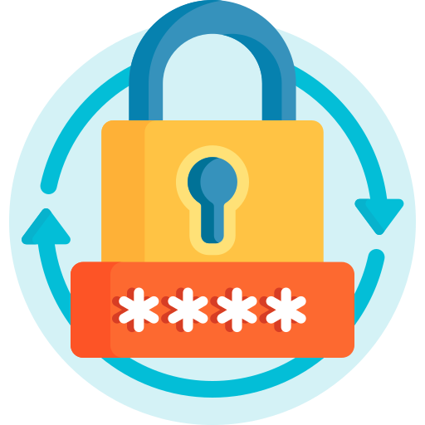

Examples of Guidelines
Email security guideline: Cautions regarding phishing scams, avoids suspicious links or attachments, and reports potential phishing attempts or suspicious emails
Password guidelines: Creates strong passwords, uses password managers, and avoids password sharing
Software updates: Updates software and operating systems regularly with the latest security patches
Notes:
Examples
Email Security guideline- Remember to be cautious of phishing scams, avoid clicking on any suspicious links or attachments, and report any potential phishing attempts. Suspicious emails.
Password guidelines: Creating strong passwords, using password managers, and not sharing passwords.
Software Updates: Keeping software and operating systems updated with the latest security patches.

Slide 45
Policy, Standard, Procedure, and Guideline
Baselines
Provides uniform methods for implementing safety measures
Guideline
Contains additional suggestions and recommendations in the guideline
Discretionary
Procedure
Offers step-by-step instructions for performing tasks in the procedure
Standard
Specifies mandatory configurations in the standard
Mandatory
Policy
States the reasons for specific actions within a company in the policy
Notes:
Explain the summary, it has already been discussed earlier in details

Slide 46
Policy, Standard, Procedure, and Guideline
 | Policies | Standards | Procedures | Guidelines
Definition | A high-level statement of organizational senior management intent | A detailed description of how policies should be implemented. | Detailed, step-by-step instructions for completing a task. | Recommended best practices or advice for carrying out a task.
Scope | Broad and organization-wide. | Specific to a policy or area. | Specific to task or process. | Broad applicability, but not mandatory.
Enforcement | Enforced through disciplinary actions or penalties | Enforced through compliance audits or certification processes | Enforced through training, monitoring and corrective actions | Not enforced, but non-compliance may result in suboptimal outcomes
Review Frequency | Annually or any change in business objectives | Periodic, based on policies or technology changes | Frequent, based on process changes | Periodic or as needed per requirements
Style | Formal, concise and authoritative | Technical, detailed, and precise. | Step-by-step, with accompanying visuals or flowcharts. | Narrative, with explanations and examples
Example | All employees and contractors must use strong passwords and follow secure management practices to protect organization’s assets and systems | Passwords must be at least 12 characters long and include a combination of upper case, lower letters and special characters. | To reset a portal: 1. Visit the password reset portal. 2. Enter your employee ID and email address. 3. Answer the security questions. | It is recommended to use a passphrase for the password.
Notes:
Explain the summary mentioned in slides

Slide 47
External Factors

Slide 48

External Considerations
External factors significantly shape an organization's compliance, operations, and strategic decisions, ensuring adherence to laws, industry standards, and global trends.
These factors dictate minimum compliance requirements, including legal obligations and industry-specific guidelines, influencing an organization's success and risk management in an interconnected world.
It is crucial to understand these influences for implementing effective security measures and ensuring compliance with external standards and laws.
Notes:
Trainer Notes:
External factors significantly shape an organization's compliance, operations, and strategic decisions, ensuring adherence to laws, industry standards, and global trends. These factors dictate minimum compliance requirements and include legal obligations and industry-specific guidelines, influencing an organization's success and risk management in an interconnected world. Understanding these influences is crucial for effective security measures and compliance with external standards and laws.

Slide 49






External Factors to Be Considered
Regulatory
Legal
Industry
National
Local or regional
Global
Notes:
External factors to be considered are listed here. The details are covered in the next 2 slides.

Slide 50
External Factors
Regulatory
Legal
Governments and regulatory bodies enact laws and regulations to ensure fair practices, protect consumers, and maintain industry standards.
Compliance with these regulations is essential to avoid legal consequences and maintain public trust.
Legal factors cover regulatory compliance, contracts, intellectual property, liability, and litigation.
Organizations need strong legal strategies to ensure ethical and lawful operations, including effective contract management and risk mitigation.
Notes:
Trainer Notes:
Regulatory-Governments and regulatory bodies enact laws and regulations to ensure fair practices, protect consumers, and maintain industry standards. Staying compliant with these regulations is essential to avoiding legal consequences and maintaining public trust
Legal-Legal factors cover regulatory compliance, contracts, intellectual property, liability, and litigation. Organizations need strong legal strategies, including effective contract management and risk mitigation, to ensure ethical and lawful operations..

Slide 51
External Factors
Industry
National
National factors involve an organization’s interactions within the country of operation.
National policies, economic trends, and geopolitical stability can significantly impact business operations.
Organizations must align their strategies with national priorities. For example, HIPAA.
Industries rapidly evolve due to technology, consumer trends, and competition.
Organizations must stay abreast of industry dynamics, embrace innovation, and adapt to changing market conditions to remain relevant and competitive.
Notes:
Trainer Notes:
Industry-Industries rapidly evolve due to technology, consumer trends, and competition. Organizations must stay abreast of industry dynamics, embrace innovation, and adapt to changing market conditions to remain relevant and competitive.
National: National factors involve an organization’s interactions within the country of operation. National policies, economic trends, and geopolitical stability can significantly impact business operations. Organizations must align their strategies with national priorities . Eg DPDP

Slide 52
External Factors
Local
Global
Local or regional considerations involve the specific rules, regulations, or cultural norms that apply to a particular geographic area.
For example, a healthcare provider in the United States must comply with HIPAA, while a similar institution in Europe would need to adhere to GDPR.
Organizations must address global challenges related to international trade, geopolitical intricacies, and cross-border compliance requirements.
A global perspective is crucial for seizing opportunities and managing risks in an increasingly interconnected business environment.
Notes:
Trainer Notes:
Local: Local or regional considerations involve the specific rules, regulations, or cultural norms that apply to a particular geographic area. For example, a healthcare provider in the United States must comply with HIPAA, while a similar institution in Europe would need to adhere to GDPR
Global: Organizations must address global challenges related to international trade, geopolitical intricacies, and cross-border compliance requirements. A global perspective is crucial to seize opportunities and skillfully manage risks in an increasingly interconnected business environment.

Slide 53
Monitoring and Revision

Slide 54

Monitoring and Revision
Monitoring and revising security measures is crucial for ensuring their effectiveness and alignment with evolving threats.
Continuous monitoring involves regularly reviewing logs and analyzing performance metrics, often facilitated by SIEM systems.
Successful monitoring and revision require a clear process, including regular review intervals, clear revision criteria, and a defined workflow for implementing changes.
This ensures that the security governance framework remains agile, allowing for quick adaptation to new challenges or opportunities
Notes:
Trainer Notes:
Monitoring and revising security measures is crucial for ensuring their effectiveness and alignment with evolving threats.
Continuous monitoring involves regular review of logs and analysis of performance metrics, often facilitated by SIEM systems.
Successful monitoring and revision require a well-defined process, including regular review intervals, clear revision criteria, and a defined workflow for implementing changes.
This ensures your security governance framework remains agile, allowing for quick adaptation to new challenges or opportunities

Slide 55
Methods for Monitoring and Revision
Regular audits and assessment
These help organizations maintain compliance and identify vulnerabilities, ensuring their controls align with current requirements.
Policy and procedure revision
Organizations must update cybersecurity policies to address new threats from compliance reports, technological advancements, changing business processes, identified risks, or evolving legal requirements.
Notes:
Trainer Notes:
Regular Audits and Assessment-Regular audits, inspections, and assessments help organizations maintain compliance and identify vulnerabilities, ensuring their controls align with current requirements
Policy and Procedure Revision-Organizations must update cybersecurity policies to address new threats triggered by compliance reports, technological advancements, changing business processes, identified risks, or evolving legal requirements. Staying abreast of the latest standards and frameworks is essential.

Slide 56
Methods for Monitoring and Revision
Legal change
Organizations must stay vigilant about changes in cybersecurity laws at all levels to ensure compliance and mitigate risks.
Cyclical and proactive approach
Continuous monitoring and revision in cybersecurity governance are crucial, forming a loop of assessment, adaptation, and enhancement.
Proactive strategies help organizations anticipate threats, assess readiness, and adjust as needed.
Notes:
Trainer Notes:
Legal Changes: Organizations must stay vigilant about changes in cybersecurity laws at all levels to ensure compliance and mitigate risks.
Cyclical and Proactive Approach: Continuous monitoring and revision in cybersecurity governance are crucial, forming a loop of assessment, adaptation, and enhancement. Proactive strategies help organizations anticipate threats, assess readiness, and make necessary adjustments in advance.

Slide 57
Roles and Responsibilities for Systems and Data

Slide 58


Data Owners
This role is crucial and carries significant weight.
The owner is typically a senior executive or department head responsible for a specific system or dataset in the organization.
Data owners are essential for managing and securing organizational data.
They are responsible for safeguarding data, enforcing usage policies, and ensuring proper data handling.
Notes:
Trainer Notes:
Data Owners
Data owner role is crucial and carries significant weight.
The owner is typically a senior executive or department head who is responsible for a specific system or data set in the organization.
Data owners are crucial in managing and securing data within an organization.
They are responsible for safeguarding data, enforcing proper usage policies, and ensuring responsible handling of data.

Slide 59

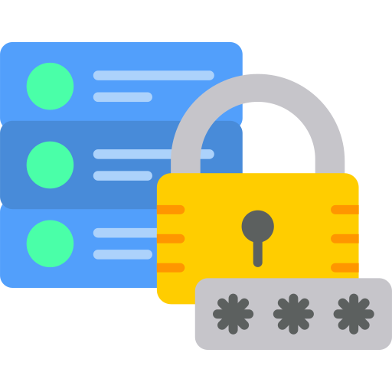

Responsibilities of Data Owners
Data classification: Involves categorizing data based on its sensitivity (confidential, public, etc.), which helps determine the appropriate security measures
Access controls: Involve defining who can access the data and determining their level of access (read-only, edit, etc.), which is crucial for data security
Security policies: Include implementing and enforcing rules to protect data from unauthorized access, modification, or deletion
Data accuracy: Involves ensuring that the data is accurate, complete, and up-to-date, which is essential for reliable decision-making
Notes:
Trainer Notes:
Data Classification: Classifying data based on its sensitivity (confidential, public, etc.) helps determine appropriate security measures.
Access Controls: Defining who can access the data and what level of access they have (read-only, edit, etc.) is crucial
Security Policies: Implementing and enforcing policies to protect data from unauthorized access, modification, or deletion
Data Accuracy: Ensuring the data is accurate, complete, and up-to-date is essential for reliable decision-making..

Slide 60




Responsibilities of Data Owners
Data lifecycle management: Establishing processes for data creation, storage, usage, archiving, and deletion throughout its lifecycle
Compliance: Understanding and adhering to relevant data privacy regulations (e.g., GDPR, CCPA) to avoid legal issues
Data sharing agreements: Defining clear terms for sharing data with third parties, if applicable
Data governance: Collaborating with data governance teams to ensure data is used responsibly and ethically
Notes:
Trainer Notes:
Data Lifecycle Management: Establishing processes for data creation, storage, usage, archiving, and deletion throughout its lifecycle
Compliance: Understanding and adhering to relevant data privacy regulations (e.g., GDPR, CCPA) to avoid legal issues
Data Sharing agreements: Defining clear terms for sharing data with third parties, if applicable.
Data Governance: collaborating with data governance teams to ensure data is used responsibly and ethically

Slide 61

Data Custodian
The data custodian securely stores and protects data, ensuring compliance with GDPR, ISO 27701, or HIPAA.
They implement data retention policies, handle the technical aspects of data storage and security, and are responsible for regular backups and recovery in case of system failure.
Other responsibilities include ensuring data is stored in compliance with laws, retaining records, and providing documentation for audits.
Notes:
Trainer Notes:
Data Owners
Data owner role is crucial and carries significant weight.
The owner is typically a senior executive or department head who is responsible for a specific system or data set in the organization.
Data owners are crucial in managing and securing data within an organization.
They are responsible for safeguarding data, enforcing proper usage policies, and ensuring responsible handling of data.

Slide 62

Data Stewards
Data stewards are dedicated to maintaining data quality, and diligently identifying and rectifying errors and inconsistencies.
They maintain detailed records and metadata, making data understandable and accessible to users.
Beyond ensuring data quality, data stewards classify data based on sensitivity and collaborate with data custodians to implement necessary controls for compliance.
Notes:
Trainer Notes:
Data stewards are dedicated to maintaining data quality, diligently identifying and rectifying errors and inconsistencies.
They also maintain detailed records and metadata, making data understandable and accessible to users.
Beyond quality, they classify data based on sensitivity and collaborate with data custodians to implement the necessary controls for compliance

Slide 63

Data Controller
Controllers determine how and why to process personal data, unlike owners who have overarching responsibility for systems or data.
The role of a data controller in an organization’s governance structure is crucial for effective data management and protection.
They are responsible for deciding how to process personal data and ensuring compliance with data protection regulations.
They write policies for data collection and processing, ensuring transparency and data protection.
Notes:
Trainer Notes:
Controllers determine how and why to process personal data, unlike owners who have overarching responsibility for systems or data.
The role of a controller in an organization’s governance structure is crucial for data management and protection.
Controllers are responsible for deciding how to process personal data and for ensuring compliance with data protection regulations.
They write policies for data collection and processing, ensuring transparency and data protection.

Slide 64


Data Processors
The data processors handle and process the data on behalf of data controllers.
They must adhere to the predetermined instructions and policies set by the controllers and ensure the sanctity of data subject rights and regulatory compliance.
They must maintain a record and audit trail for every transaction during data processing to ensure compliance by the auditor.
Notes:
Trainer Notes:
The data processor must handle and process the data on behalf of data controllers.
They must adhere to the predetermined instructions and policies set by the controllers and ensure the sanctity of data subject rights and regulatory compliance.
They must maintain a record and audit trail for every transaction during data processing so that the auditor can ensure compliance

Slide 65
Governance

Slide 66

Governance
“Governance is the combination of processes and structures implemented by the board in order to inform, direct, manage and monitor the activities of the organization toward the achievement of its objectives.” – Institute of Internal Auditor
Notes:
Trainer Notes:
What is Governance
Governance is the combination of processes and structures implemented by the board in order to inform, direct, manage and monitor the activities of the organization toward the achievement of its objectives.” – Institute of Internal Auditor

Slide 67

Information Security Governance
Information security (infosec) governance is the framework of policies, processes, and structures that an organization implements to manage and protect its information assets.
It is the overarching strategy that guides how seriously an organization takes information security and how it achieves its security goals.
Notes:
Trainer Notes:
Information security (infosec) governance is the framework of policies, processes, and structures an organisation implements to manage and protect its information assets.
It's essentially the overarching strategy that guides how seriously an organization takes information security and how it achieves its security goals.

Slide 68

Information Security Governance
Information Security Governance is intended to guarantee the following:
Reducing risks
Verifying that appropriate security activities are performed
Directing information security investments appropriately
Enabling executive management to determine program effectiveness
Notes:
Trainer Notes:
Information Security Governance is intended to guarantee
Risks are reduced
Appropriate information verifying that security activities are being performed
Information security investments are appropriately directed
The executive management can determine program effectiveness

Slide 69





Type of Governance Structures
Boards
Committees
Govt. entities
Centralized governance
Decentralized governance
Notes:
Trainer Notes:
Details are provided in the upcoming slides

Slide 70
Board
The board establishes the organization’s security direction and approves policies that align with business goals.
It often has the final approval for important security initiatives and spending, such as new security technology.
It is responsible for risk management at the highest level, ensuring that the organization's risk tolerance is clearly defined and adhered to.
It also has a fiduciary duty to stakeholders to protect assets and data, and to ensure compliance with regulatory frameworks.
Notes:
Trainer Notes:
The board establishes the organization’s security direction and approves policies to align with business goals.
The board often has final approval for important security initiatives and spending, such as new security technology.
The board is responsible for risk management at the highest level, ensuring that the organization's risk tolerance is clearly defined and adhered to.
It also has a fiduciary duty to stakeholders to protect assets and data, and to ensure compliance with regulatory frameworks..

Slide 71
Committee
A committee is a specialized body within an organization focusing on specific security or operational needs.
It deals with tactical and operational aspects of governance, unlike a board, which operates at a strategic level.
The primary role of a committee is to oversee specific security initiatives or programs.
This includes ensuring that data handling and storage practices align with GDPR requirements.
It acts as an advisory body to the board or senior management.
It conducts in-depth analyses of specific issues, such as emerging threats or regulatory changes, and presents its findings and recommendations for action.
Notes:
Trainer Notes:
A committee is a specialized body within an organization that focuses on specific security or operational needs, dealing with tactical and operational aspects of governance, unlike a board, which operates at a strategic level.
The primary role of a committee is to oversee a specific security initiative or program, such as ensuring that data handling and storage practices align with GDPR requirements.
Another key function of a committee is to act as an advisory body to the board or senior management.
It would conduct in-depth analyses of specific issues, such as emerging threats or regulatory changes, and present its findings and recommendations for action.

Slide 72
Govt. Entities
Government entities play a crucial role in governance, particularly in national security, public safety, and regulatory compliance.
They enforce standards and regulations for private organizations and handle dispute resolution and legal enforcement.
This ensures accountability and rigorous security protocols for organizations.
Notes:
Trainer Notes:
A committee is a specialized body within an organization that focuses on specific security or operational needs, dealing with tactical and operational aspects of governance, unlike a board, which operates at a strategic level.
The primary role of a committee is to oversee a specific security initiative or program, such as ensuring that data handling and storage practices align with GDPR requirements.
Another key function of a committee is to act as an advisory body to the board or senior management.
It would conduct in-depth analyses of specific issues, such as emerging threats or regulatory changes, and present its findings and recommendations for action.

Slide 73
Centralized Governance
In a centralized governance structure, decision-making authority is concentrated at the top levels of the organization, leading to quicker decision-making processes.
For example, in a centralized IT governance model, a single department might be responsible for all IT-related decisions, resulting in a uniform implementation of policies.
However, drawbacks include limited responsiveness to unique departmental needs and the potential for a single point of failure.
Notes:
Trainer Notes:
A committee is a specialized body within an organization that focuses on specific security or operational needs, dealing with tactical and operational aspects of governance, unlike a board, which operates at a strategic level.
The primary role of a committee is to oversee a specific security initiative or program, such as ensuring that data handling and storage practices align with GDPR requirements.
Another key function of a committee is to act as an advisory body to the board or senior management.
It would conduct in-depth analyses of specific issues, such as emerging threats or regulatory changes, and present its findings and recommendations for action.

Slide 74
Decentralized Governance
Decentralized governance distributes decision-making authority within an organization, allowing localized control to accommodate diverse needs and locations.
While fostering innovation, it can lead to inconsistencies.
Some organizations use a hybrid approach, combining centralized and decentralized elements.
Notes:
Trainer Notes:
Decentralized governance distributes decision-making authority within an organization, allowing localized control to accommodate diverse needs and locations.
While fostering innovation, it can lead to inconsistencies.
Some organizations use a hybrid approach, combining centralized and decentralized elements

Slide 75
Major Focus of Information Security Governance
Risk management
Resource management
Performance measurement
Strategic alignment
Value delivery
Notes:
Trainer Notes:
The major focus of governance is on:
Risk Management: Resource management in information security governance involves efficiently allocating and utilizing personnel, technology, and financial resources to achieve security objectives and maximize the return on security investments.
Resource Management: Resource management in information security governance involves efficiently allocating and utilizing personnel, technology, and financial resources to achieve security objectives and maximize the return on security investments.
Performance Measurement: Performance measurement in information security governance is crucial for assessing the effectiveness and efficiency of security initiatives. It involves establishing key performance indicators (KPIs) to monitor security performance against defined objectives
Strategic Alignment: Security actions must align with an organization's business objectives. This strategic alignment in information security governance ensures that security efforts directly support the organization's overall business objectives.
Value Delivery: It is the process of ensuring that security investments align with and contribute to the overall business objectives, demonstrating tangible benefits such as reduced risk, improved efficiency, and increased revenue.

Slide 76

Governance, Risk Management, and Compliance (GRC)
The GRC of every organization varies based on the type of organization.
It depends on an organization’s mission, size, industry, culture, and legal regulations.
G
R
C
GOVERNANCE
RISK
COMPLIANCE
The ultimate responsibility of the GRC program is to
protect their assets and operations, including their IT infrastructure and information.
Notes:
Trainer Notes:
Let’s understand Governance, Risk Management, and Compliance (GRC)
GRC stands for Governance, Risk Management, and Compliance.
The GRC of every organization is different and varies based on the type of organization.
It depends on an organization’s mission (business), size, industry, culture, and legal regulations.
Ultimate responsibility of GRC program is to protect
their assets and operations, including their IT infrastructure and information.

Slide 77

Governance, Risk Management, and Compliance (GRC)
Governance
It is the responsibility of the board of directors and senior management of the organization.
Notes:
Trainer Notes:
What is Governance?
Governance is the responsibility of the board of directors and senior management of the organization.
Governance is the set of responsibilities and practices exercised by the board and executive management to provide strategic direction, ensure objectives are achieved, ascertain that risks are managed appropriately, and verify that the enterprise’s resources are used responsibly.

Slide 78

Governance, Risk Management, and Compliance (GRC)
A governance program has the following goals:
Ensure risk is being managed appropriately
Verify responsible use of the organization’s resources
Ensure objectives are achieved
Provide strategic direction
Notes:
Trainer Notes:
Verify that the organization’s resources are being used responsibly
Ascertain whether risk is being managed appropriately
Provide strategic direction
Ensure that objectives are achieved
A governance program has several goals

Slide 79
Governance, Risk Management, and Compliance (GRC)
It is the process of managing risk to acceptable levels within an organization.
It involves developing and implementing internal controls to manage and mitigate various risks, including financial, investment, physical, and cyber risks.
Risk management
It is the act of adhering to and demonstrating compliance with mandated requirements defined by laws and regulations.
It also includes voluntary requirements resulting from contractual obligations and internal policies.
Compliance
Notes:
Trainer Notes:
Risk Management:
Risk Management is the process by which an organization manages risk to acceptable levels.
It requires the development and implementation of internal controls to manage and mitigate risk throughout the organization, including financial and investment risk, physical risk, and cyber risk.
Compliance:
Compliance is the act of adhering to, and the ability to demonstrate adherence to, mandated requirements defined by laws and regulations.
It also includes voluntary requirements resulting from contractual obligations and internal policies.

Slide 80
Elements of the Risk Management Process

Slide 81
Security Definitions
Asset: Any information, software, hardware, or equipment utilized for, and critical to, business objectives, service delivery, and financial success
1
2
Vulnerability: Any hardware, software, or procedural weakness that may allow unauthorized access to resources
Threat: Any potential danger to systems or information
3
4
Threat Agent: Any entity that exploits a vulnerability
Risk: The likelihood of a threat agent exploiting a weakness or vulnerability, resulting in business impact
5
6
Exposure: An instance of being exposed to losses from a threat agent
Countermeasure or safeguard: Measures implemented to mitigate potential risks
7
Notes:
Trainer Notes:
Explain the definitions given on the slide.

Slide 82

Business Scenario
While studying the information risk management process, Kevin made notes on security definitions based on examples from his day-to-day work:
Asset: Servers and systems of the company
Vulnerability: Weak rule in firewall
Threat: Hacking network or servers
Threat Agent: Hacker
Risk: Loss of critical organizational data
Exposure: 25% loss of data (which is unencrypted)
Question: What will the risk management process achieve?
Notes:
Trainer Notes:
Go through the scenario and ask the given question to the learners.

Slide 83
Business Scenario
While studying the information risk management process, Kevin made notes on security definitions based on examples from his day-to-day work:
Asset: Servers and systems of the company
Vulnerability: Weak rule in firewall
Threat: Hacking network or servers
Threat Agent: Hacker
Risk: Loss of critical organizational data
Exposure: 25% loss of data (which is unencrypted)
Question: What will the risk management process achieve?
Answer: It helps to maintain the identified risks at an acceptable level.
Notes:
Trainer Notes:
Explain the answer given on the slide.

Slide 84
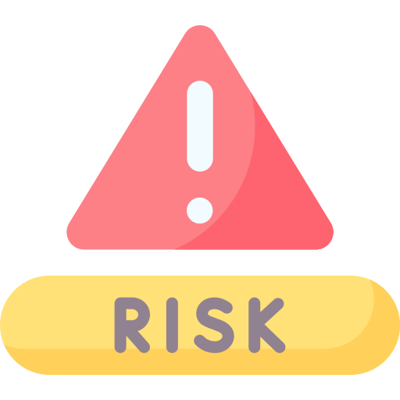
Risk Assessment
Risk assessment is a systematic and structured process where the organization:
Identifies, analyzes, and evaluates risks associated with potential threats and vulnerabilities
Makes informed decisions and prioritizes resource allocation effectively
Notes:
Risk Assessment:
Risk assessment is a systematic and structured process where the organization identifies, analyzes, and evaluates risks associated with potential threats and vulnerabilities to make informed decisions and prioritize resource allocation effectively

Slide 85

Types of Risk Assessments
The different types of risk assessments include:
Ad hoc risk assessment
Recurring risk assessment
One-time risk assessment
Continuous risk assessment
Notes:
Trainer Notes:
Explain types of Risks; explained in details in next slide

Slide 86
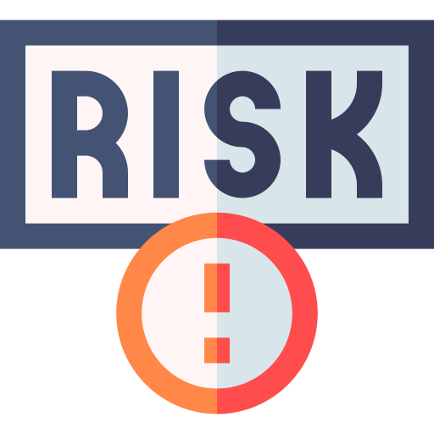
Types of Risk Assessments
Ad hoc risk assessments
Recurring risk assessments
Ad hoc assessments are sporadic and arise in response to specific events or perceived threats. This type of assessment focuses on immediate dangers and is characterized by flexibility and swift implementation.
Recurring assessments are routine and scheduled to occur at predetermined intervals. This approach ensures that the organization's security posture is regularly monitored, evolving threats are detected, and changes in the environment or operations are addressed.
Notes:
Types of Risk Assessment:
Ad hoc risk assessments
Ad hoc assessments are sporadic and arise in response to specific events or perceived threats. This type of assessment is tailored to focus on the immediate dangers and is characterized by its flexibility and swift implementation
Recurring risk assessments
Recurring assessments are routine and scheduled to occur at predetermined intervals. This approach ensures that the organization’s security posture is regularly monitored, evolving threats are detected, and changes in the environment or operations are addressed

Slide 87
Types of Risk Assessments
One-time risk assessments
Continuous risk assessments
One-time assessments are conducted for specific scenarios or projects, often at the inception of a new venture, system implementation, or organizational change.
Continuous risk assessment goes beyond the periodic nature of recurring assessments. It is characterized by real-time monitoring and risk analysis. This dynamic approach integrates risk assessment into the organization's daily operations, allowing instantaneous detection and response to threats as they arise.
Notes:
Types of Risk Assessment
One-time risk assessment
One-time assessments are conducted for specific scenarios or projects, often at the inception of a new venture, system implementation, or organizational change.
Continuous risk Assessments
Continuous risk assessment goes above and beyond the periodic nature of recurring assessments. It is characterised by real-time monitoring and risk analysis. This dynamic approach integrates risk assessment seamlessly into the organization’s daily operations, allowing for instantaneous detection and response to threats as they arise.

Slide 88
Information Risk Management
Information risk management is the process of identifying and assessing risk, reducing it to an acceptable level, and implementing the right mechanisms to maintain it at that level.
Recognition of the uncertainty
Threat impact
Annualized cost
Threat event
Threat frequency
Risk mitigation
Cost or benefit analysis
Notes:
Trainer Notes:
Information Risk Management is the process of identifying and assessing risk, reducing it to an acceptable level, and implementing the right mechanisms to maintain it at that level.
For a risk to exit, there should be threat event i.e worm outbreak, followed by determining the impact and frequency of threat event which help in calculating the risk.Once risk is calculated, we will look at different mitigation methods , followed by annualized cost of control and ensuring that cost of control doesn’t exceed cost of asset

Slide 89
Risk Management: Steps
There are four steps in the risk management life cycle:
1 .IT risk identification
2. IT risk analysis
Risk management life cycle
4. Risk and control monitoring
And reporting
3. Risk response and mitigation
Notes:
Trainer Notes:
IT risk management is a cyclical process.
The first phase in the IT risk management process is IT risk identification, which includes determining the risk context and risk framework, and the process of identifying and
documenting risk.
The next phase is IT risk assessment, which includes assessing and prioritizing risk to provide management with the data needed for risk response and mitigation.
The third phase of the cycle is risk response and mitigation, which addresses how organizations respond once risk is determined, based on results of risk assessments.
The final phase is risk and control monitoring and reporting, which addresses how organizations monitor risk over time.
This cycle is repeated as the risk environment changes due to internal or external factors.

Slide 90

1- Risk Identification
Risk identification is the process of documenting any risks that could prevent an organization or program from reaching its objectives. It includes the following key points:
The first step in the risk management process, designed to help companies understand and plan for potential risks
The process of discovering, categorizing, and documenting risks to an organization
Important because only identified risks can be evaluated and addressed with suitable responses
Notes:
Trainer Notes:
An investigation is a systematic, minute, and thorough attempt to learn the facts about something complex or hidden. It is often formal and official.
Example: Investigation of a bank failure
Digital investigations involve investigations of all crimes conducted using computer and related technologies where the evidence exists in an electronic or a digital form or in a storage or on a wire.
Investigation of computer crimes is also known as computer forensics.

Slide 91






Risk Identification Method
Methods for identifying risks include:
Brainstorming
Interviews
Questionnaires
OEM updates
Regular testing
Subscriptions to blogs
Notes:
Trainer Notes:
Brainstroming-Continuous risk Assessments
Continuous risk assessment goes above and beyond the periodic nature of recurring assessments. It is characterised by real-time monitoring and risk analysis. This dynamic approach integrates risk assessment seamlessly into the organization’s daily operations, allowing for instantaneous detection and response to threats as they arise.
Interviews-Interviews are a crucial component of the risk identification phase in a comprehensive risk assessment. They provide valuable insights into potential risks that might be overlooked through other methods like document analysis or brainstorming.
Questionnares-Questionnaires are a structured approach to gathering information for risk identification. They provide a standardized method for collecting data from various stakeholders across an organization.
OEM- Original equipment Manufactures- OEM like cisco, macfee release updates about risk
Regular testing- Regular VA/PT can help in identification of risk
Subscription to blogs- by subscribing to blogs, technical forums can help in identification of risk

Slide 92
2- Risk Analysis
Risk analysis is the analysis of the probability and consequences of each known risk.
Risk analysis prioritizes risks and calculates the cost of safeguards.
It provides a cost/benefit comparison between cost of safeguards and cost of loss.
It identifies and prioritizes the risk factors with great impact.
It also integrates the security program objectives with the organization’s business objectives and requirements.
Notes:
Trainer Notes:
Risk analysis is the analysis of the probability and consequences of each known risk.
Risk analysis prioritizes risks and calculates the cost of safeguards.
It provides a cost/benefit comparison between cost of safeguards and cost of loss.
It identifies and prioritizes the risk factors with great impact.
It also integrates the security program objectives with the organization’s business objectives and requirements.

Slide 93

Goals of Risk Analysis
Identifying organizational assets and their value
Identifying vulnerabilities and threats
Measuring the probability and impact of latent threats
Goals of Risk Analysis
Balancing the cost of countermeasures and the impact of threats
Notes:
Trainer Notes:
Let’s understand the goals of risk analysis.
To balance the cost of countermeasure and the impact of threats
To measure probability and the impact of latent threats
To identify vulnerabilities and threats
To identify organizational assets and their value

Slide 94


Asset Valuation
The following issues should be considered when assigning values to an asset:
Cost to acquire or develop the asset
Cost to maintain and protect the asset
Value of the asset to owners and users
Value of the asset to adversaries
Value of intellectual property that went into developing the information
Price others are willing to pay for the asset
Cost to replace the asset if lost or damaged.
Operational and production activities that are affected if the asset is unavailable
Liability issues if the asset is compromised
Usefulness and role of the asset in the organization
Notes:
Trainer Notes:
The following issues should be considered when assigning values to an asset:
Cost to acquire or develop the asset
Cost to maintain and protect the asset
Value of the asset to owners and users
Value of the asset to adversaries
Value of intellectual property that went into developing the information
Price others are willing to pay for the asset
Cost to replace the asset if lost or damaged

Slide 95

Risk Analysis Team
An organization needs to form a risk analysis team to analyze risks effectively. These are the stakeholders in a risk analysis team:
Information security officer
Risk
Manager
Executive sponsor
System or network administrator
Risk Analysis Team
System technical
Owner
System business owner
Notes:
Trainer Notes:
An organization needs to form a risk analysis team to analyze risks effectively. These are the stakeholders in a risk analysis team:
Risk Manager
System or Network Administrator
System Business Owner
System Technical Owner
Executive Sponsor
Information Security Officer

Slide 96
Risk Analysis Team
The steps to perform risk analysis:
Risk analysis and assessment
Asset and information value assignment
Countermeasure selection and implementation
Notes:
Trainer Notes:
The steps to perform risk analysis are:
Asset and information value assignment
Risk analysis and assessment
Countermeasure selection and implementation

Slide 97
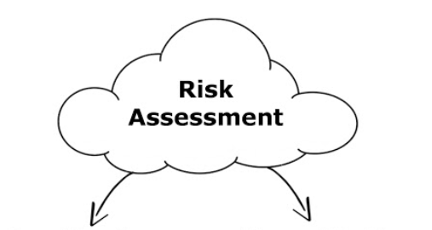
Types of Risk Analysis
Quantitative
Qualitative
Uses risk calculations that attempt to predict the level of monetary losses and the percentage of chance for each type of threat
Is objective in nature
Is situation and scenario based
Is subjective in nature
Does not assign numbers and monetary values to components and losses
Notes:
Quantative-Uses risk calculations that attempt to predict the level of monetary losses and the percentage of chance for each type of threat
Is objective in nature
Qualitative-Is situation and scenario based
Is subjective in nature
Does not assign numbers and monetary values to components and losses

Slide 98
Key Terms in Quantitative Risk Analysis
Asset
Total value of assets
Percentage of loss the organization would suffer if a risk materializes
Also referred to as the loss potential
Exposure factor
Cost associated with a single realized risk against a specific asset
Calculated as SLE = AV (Asset Value) * EF (Exposure Factor)
Expressed in dollars
Single Loss Expectancy (SLE)
Notes:
Trainer Notes:
Asset
Total value of assets
Exposure Factor:
Percentage of loss the organization would suffer if a risk materializes
Also referred to as the loss potential
Single Loss Expectancy (SLE):
Cost associated with a single-realized risk against a specific asset
SLE = AV * EF
It is calculated in dollars

Slide 99
Key Terms in Quantitative Risk Analysis
Frequency with which a specific threat will occur within a single year
Ranges from 0 (threat will not occur) to large numbers
Also known as probability determination
Annualized Rate of Occurrence (ARO)
Annualized Loss Expectancy (ALE)
Possible yearly cost of all instances of a specific threat realized against a specific asset
Calculated as ALE = SLE * ARO
Annual Cost of Safeguard (ACS)
Cost associated with procuring, developing, and maintaining control against a potential threat
ACS should not exceed the ALE
The cost associated in procuring, developing, and maintaining control against a potential threat
The ACS should not exceed the ALE
Notes:
Trainer Notes:
Annualized Rate of Occurrence (ARO):
Frequency with which a specific threat will occur within a single year
Ranges from 0 (threat will not occur) to large numbers
Also known as probability determination
Annualized Loss Expectancy (ALE):
Possible yearly cost of all instances of a specific threat realized against a specific asset
ALE = SLE * ARO
Annual Cost of Safeguard (ACS)
The cost associated in procuring, developing, and maintaining control against a potential threat
The ACS should not exceed the ALE

Slide 100
Quantitative Risk Analysis Steps
Step 1: Assign asset value
Step 6: Perform cost or benefit analysis of countermeasure
Step 2: Calculate exposure factor
Steps in quantitative risk analysis
Step 5: Derive annualized loss expectancy(ALE)
Step 3: Calculate single loss expectancy (SLE)
Step 4: Assess annualized rate of occurrence(ARO)
Notes:
Trainer Notes:
Let’s go through Quantitative Risk Analysis Steps
Step 1: Assign asset value
Step 2: Calculate exposure factor
Step 3: Calculate single loss expectancy
Step 4: Assess annualized rate of occurrence
Step 5: Derive annualized loss expectancy
Step 6: Perform cost or benefit analysis of countermeasure

Slide 101
Quantitative Risk Analysis: Problem
?
Problem: A fire destroys a server with encrypted data. Consider the following conditions:
Asset value: $6,000
Exposure factor (EF): 50%
Annualized rate of occurrence (ARO): 10% chance of fire in one year
Solution:
Single Loss Expectancy (SLE): $6,000×50%=$3,000$6,000×50%=$3,000
Annual Loss Expectancy (ALE): 10%×$3,000=$30010%×$3,000=$300
Notes:
Trainer Notes:
Explain the problem and solution given on the slide.

Slide 102
Qualitative Risk Analysis
The following issues should be considered when assigning values to an asset:
Probability and impact assessment: Risks are scored based on their likelihood of occurring and their impact on project objectives
Use of judgment and experience: Relies on judgment, best practices, intuition, and the experience of people to evaluate and measure risks
Threat | Threat Probability | Impact | Countermeasure
Fire | Low | High | Fire Extinguishers
Theft | Medium | High | Key cards, guards
Logical Intrusion | Medium | High | Intrusion prevention system
Notes:
Trainer Notes:
Qualitative Risk Analysis
Qualitative risk analysis prioritizes the identified project risks using a pre-defined rating scale.
Risks will be scored based on their probability or likelihood of occurring and the impact on project objectives should they occur
It uses judgment, best practices, intuition, and experience of people to judge and measure risk

Slide 103
Risk Matrix
A risk matrix is a tool used to determine the level of risk and aid in decision-making. The matrix evaluates risks based on their likelihood and impact:
 |  | IMPACT
 |  | Negligible (1) | Minor (2) | Moderate (3) | Significant (4) | Severe (5)
 | Very Likely (5) | 5 | 10 | 15 | 20 | 25
 | Likely (4) | 4 | 8 | 12 | 16 | 20
 | Possible (3) | 3 | 6 | 9 | 12 | 15
 | Unlikely (2) | 2 | 4 | 6 | 8 | 10
 | Very Unlikely (1) | 1 | 2 | 3 | 4 | 5
LIKELIHOOD
Notes:
A risk matrix is a visual tool used to assess and prioritize risks based on their likelihood of occurrence and potential impact. It helps organizations understand the overall risk landscape and allocate resources effectively to mitigate the most critical risks.
How a Risk Matrix Works
Identify Risks: List potential risks that could affect the project or organization.
Assess Likelihood: Estimate the probability of each risk occurring on a scale (e.g., low, medium, high).
Assess Impact: Evaluate the potential impact of each risk on a scale (e.g., low, medium, high).
Plot Risks: Position each risk on the matrix based on its likelihood and impact.
Prioritize Risks: Focus on risks in the high-likelihood, high-impact quadrant.

Slide 104
Qualitative Risk Analysis
Qualitative analysis techniques include judgment, best practices, intuition, and experience. Examples of qualitative techniques to gather data are:
Delphi
Brainstorming
Storyboarding
Focus Groups
Questionnaires
Surveys
Checklists
One-on-one meetings
Interviews
Notes:
Trainer Notes:
Qualitative analysis techniques include judgment, best practices, intuition, and experience. Examples of qualitative techniques to gather data are:
Delphi-The Delphi Technique is a structured group communication process used to elicit expert opinions on a particular topic. It's particularly valuable in risk assessment for gathering qualitative data and building consensus among experts.
Brainstorming-Brainstorming is a fundamental technique in qualitative risk analysis. It's a collaborative process where team members contribute ideas to identify potential risks. The goal is to generate a comprehensive list of potential threats and vulnerabilities
Storyboarding-Storyboarding is an unconventional but powerful tool for visualizing and understanding potential risk scenarios. It's particularly useful in qualitative risk analysis where the focus is on understanding the narrative of a risk event.
Focus Groups-Focus groups are a valuable qualitative research method for identifying and understanding risks within an organization. By bringing together a group of individuals with relevant knowledge and experience, focus groups can generate rich insights into potential threats and vulnerabilities
Surveys-Surveys are a valuable tool for gathering quantitative and qualitative data in risk analysis. They provide a structured approach to collecting information from a large number of respondents, allowing for efficient data collection and analysis
Questionnaires-While questionnaires are primarily associated with quantitative research, they can also be valuable tools in qualitative risk analysis. By carefully crafting open-ended questions, you can gather rich, descriptive data about perceptions, attitudes, and experiences related to risk.
Checklists-A checklist can be a valuable tool for ensuring a comprehensive and consistent approach to qualitative risk assessment. It helps to structure the process and ensure that no critical aspects are overlooked.
One-on-one meetings-One-on-one meetings are an essential component of qualitative risk assessment. They provide an opportunity for in-depth discussions, allowing for a deeper understanding of individual perspectives and the potential risks associated with specific roles or areas.
Interviews-Interviews are a cornerstone of qualitative risk analysis, providing rich, in-depth insights into the perceptions, experiences, and knowledge of individuals within an organization.

Slide 105
Qualitative and Qualitative Risk Analysis
The approach to risk analysis will be decided based on the risk analysis team, management, risk analysis tools, and the culture of the company. Key attributes of each approach include:
Attributes | Quantitative | Qualitative
Requires complex calculations | √ | X
Requires high degree of guess work | X | √
Provides credible cost/benefit analysis | √ | X
Provides opinions of the individuals who know the process well | X | √
Shows clear-cut losses that can be accrued within one year | √ | X
Notes:
Trainer Notes:
The type of approach to risk analysis will be decided based on the risk analysis team, management, risk analysis tools, and culture of the company.
The chart below sorts different attributes into qualitative and quantitative risk analysis.
Please explain the table given on the screen.

Slide 106

Hybrid Analysis
Hybrid analysis uses both quantitative and qualitative analysis. The following points highlight why hybrid analysis is required:
It is almost impossible to carry out only quantitative assessment
Qualitative analysis does not provide sufficient data to make financial decisions
Quantitative evaluation is used for financial values of tangible assets
Qualitative assessment can be used for priority values of intangible assets
Notes:
Trainer Notes:
Hybrid analysis uses both quantitative and qualitative analysis. The following are some points about why hybrid analysis is required:
It is almost impossible to carry out only quantitative assessment.
Qualitative analysis does not provide sufficient data to make financial decisions.
Quantitative evaluation is used for financial values of tangible assets.
Qualitative assessment can be used for priority values of intangible assets.

Slide 107

Risk Register
A risk register is a centralized repository that records identified risks, their characteristics, and their management plans. Key aspects of a risk register include:
Centralized documentation: Provides a detailed log of risks identified during a risk assessment
Structured risk management: Offers a way to track and evaluate risks over time
Inclusion of Key Risk Indicators (KRIs): Identifies risk owners and specifies the risk threshold
Effective monitoring and management: Helps organizations monitor and manage risks effectively
Notes:
Explain Risk Registers
A risk register is a centralized repository that records identified risks, their characteristics, and their management plans.
A risk register is a crucial document in risk management processes that provides a detailed log of risks identified during a risk assessment
It is a critical risk management tool that provides a structured way to track and evaluate risks over time.
It includes Key Risk Indicators (KRIs), identifies risk owners, and specifies the risk threshold, helping organizations monitor and manage risks effectively

Slide 108
Components of Risk Registers
Risk ID
Description
Current status
The risk ID is a unique identifier for each risk, making it easier to track and manage. It is usually a numeric or alphanumeric code. Assigning a unique ID to each risk ensures that no ambiguity exists when discussing or monitoring it.
The description provides a brief but clear explanation of the risk, outlining what it is and why it is a concern. A well-articulated description ensures that everyone in the organization understands the nature of the risk, which is crucial for effective management and mitigation.
The current status indicates whether the risk is above or below the defined threshold. This helps in monitoring the risk’s progression and impact over time.
Notes:
Components of Risk Register
Risk ID-The risk ID is a unique identifier for each risk that makes it easier to track and manage risks. It’s usually a numeric or alphanumeric code. Assigning a unique ID to each risk ensures that no ambiguity exists when discussing or monitoring it.
Description-The description provides a brief but clear explanation of the risk, outlining what it is and why it’s a concern. A well-articulated description ensures that everyone in the organization understands the nature of the risk, which is crucial for effective management and mitigation
Current Status-The current status indicates whether the risk is above or below the defined threshold

Slide 109
Components of Risk Registers
Key risk indicator
Risk owners
Risk threshold
KRIs are an essential element of a risk register. They serve as metrics that provide an early signal of increasing risk exposure in various areas of the organization. KRIs act as early indicators of risk and are instrumental in anticipating potential problems and allowing organizations to enact proactive measures to mitigate such risks.
A risk owner is an individual or team assigned to risk management. The risk owner is responsible for implementing risk mitigation strategies and monitoring their effectiveness over time.
The risk threshold is the level of risk that an organization is willing to accept before action is required. Setting a risk threshold helps automate the risk response process. If a risk crosses this threshold, it triggers a predefined action or escalation, ensuring timely intervention.
Notes:
Components of Risk Registers-
KRI-KRIs are an essential element of a risk register. They serve as metrics that provide an early signal of increasing risk exposure in various areas of the organization. KRIs act as early indicators of risk and so are instrumental in anticipating potential problems and allowing organizations to enact proactive measures to mitigate such risks
Risk Owners-A risk owner is an individual or team assigned to risk management. The risk owner is responsible for implementing risk mitigation strategies and monitoring their effectiveness over time.
Risk Thresholds-The risk threshold is the level of risk that an organization is willing to accept before action is required. Setting a risk threshold helps automate the risk response process. If a risk crosses this threshold, it triggers a predefined action or escalation, ensuring timely intervention.

Slide 110
Sample Risk Register
Risk ID | Description | Indicator | Owner | Threshold | Status | Plan
1 | Data breach | Financial loss | IT Dept | $10,000 | Under Threshold | Implement 2FA
2 | Non-compliance | Legal penalties | Legal Dept | 2 incidents | Over Threshold | Review compliance policy
3 | Supply chain disruption | Operational delay | Ops Dept | 5 days | Under Threshold | Diversify suppliers
4 | Reputational damage | Customer churn | Marketing | 10% | Under Threshold | Crisis communication plan
Notes:
Explain the sample Risk Register

Slide 111



Risk Response
The risk response phase of risk management focuses on the decisions made regarding the correct way to respond to risk. This phase involves identifying, evaluating, and implementing strategies to address risks effectively.
Notes:
Explain RIsk Response

Slide 112

Handling Risk
Risk treatment can be done in the following four ways:
Transfer the risk
1
Accept the loss
4
2
Terminate the risk activity
3
Take measures
Notes:
Trainer Notes:
Risk treatment can be done in the following four ways:
Transfer the risk
Terminate the risk activity
Take measures
Accept the loss

Slide 113
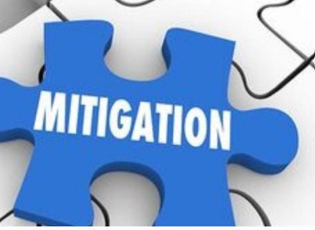
Risk Mitigation
Risk mitigation involves implementing safeguards and countermeasures to eliminate vulnerabilities or block threats. Effective risk mitigation strategies include:
Example: Implementing Intrusion Prevention Systems (IPS) and Data Loss Prevention (DLP)
Implementing a Web Application Firewall (WAF) to address the shortcomings of a network firewall in handling web application attacks
Notes:
Trainer Notes:
Risk Mitigation
By implementing safeguards and countermeasures to eliminate vulnerabilities or block threats.
Example:
Implementing IPS,DLP
Implementing Web application Firewall to fill for shortcoming of network firewall to handle web application attack

Slide 114
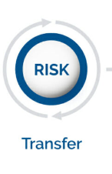
Risk Transfer
Risk transfer involves shifting the cost of loss a risk represents onto another entity or organization. This strategy helps manage risk by transferring the financial burden. Examples of risk transfer include:
Cyber Insurance: Purchasing insurance to cover potential cyber-related losses.
Outsourcing: Contracting out certain business functions to third-party organizations, transferring the associated risks.
Notes:
Trainer Notes:
Risk Transfer
Placement of the cost of loss a risk represents onto another entity or organization.
Example:
Cyber Insurance
Outsourcing

Slide 115
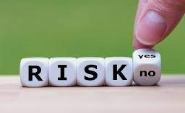
Risk Acceptance
Risk acceptance occurs when the cost/benefit ratio indicates that the cost of the countermeasure outweighs the potential loss value. This strategy involves recognizing the risk and deciding not to take any action to mitigate it. Examples of situations where risk acceptance might be appropriate include:
The cost of the asset is less than the cost of the countermeasure.
Changes in government policies.
Changes in client policies.
Notes:
Trainer Notes:
Explain the problem and solution given on the slide.

Slide 116
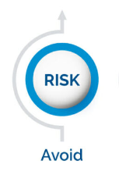
Risk Avoidance
Risk avoidance involves terminating the associated activity that introduces the risk. This strategy is
Not buying a property or business to avoid taking on the liability that comes with it.
Not flying to avoid the risk of the airplane being hijacked.
Notes:
Trainer Notes:
Risk Avoidance
By terminating the associated activity that introduces the risk .
Example:
An example would be not buying a property or business in order to not take on the liability that comes with it.
Another would be not flying in order to not take the risk that the airplane were to be hijacked.

Slide 117


Residual Risk
Inherent Risk
Residual risk is the risk that remains after countermeasures and controls have been implemented. This type of risk acknowledges that it is not always possible to eliminate all risks entirely.
Impact of Risk controls
Residual Risk
Notes:
Discuss Residual Risk
Residual risk is the risk that remains after countermeasures and controls have been implemented.
Any losses that occur from residual risk are the responsibility of management.

Slide 118


Residual Risk
Trade-offs in risk management: Reducing one risk inevitably introduces another risk, hopefully of a lesser nature.
Persistent nature of risk:
Risk is never fully eliminated, and residual risk always remains.
Acceptable Risk Levels:
Residual risk should be equal to the organization's criteria for acceptable risk and risk tolerance.
Notes:
Residual risk is the amount of risk that remains after risk management strategies have been implemented. It's the leftover risk that couldn't be completely eliminated or transferred.
Residual risk should be equal to the organization’s criteria for acceptable risk and risk tolerance
It is always the responsibility of senior management

Slide 119
Residual Risk Mitigation
Here is a flowchart that explains the steps in the risk mitigation process:
Risk < Acceptable level ?
Yes
No
Mitigate risk
Accept risk
No
Mitigation cost > Asset
value
Yes
Notes:
Trainer Notes:
Explain the flowchart given on the slide.

Slide 120



Risk Capacity, Risk Appetite and Risk Tolerance
Risk capacity:
The maximum risk an organization can afford to take.
Risk appetite:
The amount of risk an organization is willing to take.
Risk tolerance: Acceptable deviations from the risk appetite.
Notes:
Mr. A's total savings are $1,000. He wants to invest in equities to earn some income. Since he is risk averse, he decides to invest only up to $700. If the markets are good, he is willing to invest a further $50. In terms of risk capacity, risk appetite, and risk tolerance, the following can be derived:
Risk capacity: Total amount available, i.e., $1,000
Risk appetite: Mr. A's willingness to take a risk i.e., $700
Risk tolerance: Acceptable deviation from the risk appetite, i.e., $750

Slide 121

Risk Capacity, Risk Appetite and Risk Tolerance
Risk capacity: Risk capacity is always greater compared to tolerance and appetite.
Risk Capacity
Risk Tolerance
Risk tolerance: Tolerance can either be equal to or greater than appetite. Risk tolerance levels are acceptable deviations from risk appetite.
Risk Acceptance
Risk acceptance: Risk acceptance should generally be within the risk appetite of the organization. It should never exceed the risk capacity.
Notes:
Explain about Script Kiddies

Slide 122
Aggregated Risk and Cascading Risk
Aggregated risk:
Cascading risk
It refers to a significant impact caused by a large number of minor vulnerabilities. Individually, these minor vulnerabilities may not have a major impact, but when exploited simultaneously, they can cause a substantial impact.
It occurs when one failure leads to a chain reaction of failures. This is particularly relevant where IT and operations have close dependencies. The security manager should consider the impact of one activity's failure on other dependent systems.
Notes:
Trainer Notes:
Patch management involves:
Scheduling and prioritizing patches
Testing the patches
Changing management
Installing and deploying patches
Auditing and assessment
Compliance

Slide 123
Countermeasure Selection: Problem
A commonly used cost/benefit calculation for a given safeguard is as follows: Value of the safeguard to the company = (ALE before implementing safeguard) - (ALE after implementing safeguard) - (Annual cost of safeguard)
Problem:
ALE of the threat of a fire bringing down a web server prior to implementing the suggested safeguard = $10,000
ALE after implementing the safeguard= $2,000
Annual cost of maintenance and operation of the safeguard = $500
Solution:
Value of the safeguard to the company = $10,000 -$2,000 -$500
= $7,500
Notes:
Trainer Notes:
Explain the problem and solution given on the slide.

Slide 124
Countermeasure Selection: Other Factors
Other factors that influence the selection of a countermeasure or safeguard include:
Total Cost of Ownership (TCO)
TCO is the total cost of a mitigating safeguard
Return on Investment (ROI)
ROI is the amount of money saved by implementing a safeguard
Uncertainty refers to the degree to which you lack confidence in an estimate. This is expressed as a percentage, from 0 to 100 percent. For example, if you have a 25 percent confidence level in something, it means you have a 75 percent uncertainty level.
Uncertainty
Notes:
Trainer Notes:
Other factors that influence the selection of countermeasure or safeguard:
Total Cost of Ownership (TCO): TCO is the total cost of a mitigating safeguard
Return on Investment (ROI): ROI is the amount of money saved by implementing a safeguard
Uncertainty: Uncertainty refers to the degree to which you lack confidence in an estimate. This is expressed as a percentage, from 0 to 100 percent. If you have a 25 percent confidence level in something, then it could be said that you have a 75 percent uncertainty level.

Slide 125
Risk Response
Risk response involves the following:
Evaluating countermeasures, safeguards, and security controls using a cost/benefit analysis
Adjusting findings based on other conditions, concerns, priorities, and resources
Providing a proposal of response options in a report to senior management

Slide 126
Controls or Countermeasures
Physical control
Security controls are the measures taken to safeguard an information system from attacks against the confidentiality, integrity, and availability of the information system.
Security controls are selected and applied based on a risk assessment of the information system.
The risk assessment process identifies system threats and vulnerabilities, and then security controls are selected to reduce or mitigate the risk.
Controls based on implementation
Technical control
Administrative control
Categories of controls
Deterrent control
Preventive control
Detective control
Controls based on functionality
Corrective control
Recovery control
Compensating control
Notes:
Trainer Notes:
Security controls are the measures taken to safeguard an information system from attacks against the confidentiality, integrity, and availability of the information system.
Security controls are selected and applied based on a risk assessment of the information system.
The risk assessment process identifies system threats and vulnerabilities, and then security controls are selected to reduce or mitigate the risk.
Explain how the categorization of controls is done.

Slide 127

Security Controls
Security controls are put in place to reduce the risk an organization faces. These controls are necessary to protect the confidentiality, integrity, and availability of your assets.
Notes:
Define Security Controls and its importance

Slide 128


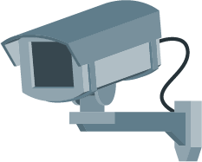
Control Categories
Administrative controls
Technical controls
Physical controls
Notes:
Mention each type of Control Categories

Slide 129
Administrative Controls
Administrative controls are managerial controls that focus on personal and business practices. These are the policies and procedures defined by an organization's security policy and other regulations or requirements.
Administrative controls are managerial controls with a focus on personal and business practices.
These are the policies and procedures defined by an organization's security policy and other regulations or requirements.
Examples of administrative controls include security documentation, risk management, personnel security, and training.
Notes:
Explain Administrative Controls with examples
Administrative controls are managerial controls with a focus on personal and business practices.
These are the policies and procedures defined by an organization's security policy and other regulations or requirements.
Examples of administrative controls are security documentation, risk management, personnel security, and training.

Slide 130
Technical Controls
Technical controls, also known as logical controls, are implemented as systems (hardware, software, or firmware) to manage and protect information assets.
Technical controls are implemented as systems (hardware, software, or firmware).
Examples of technical controls include firewalls, Intrusion Prevention Systems (IPS), antivirus software, and encryption.
Notes:
Explain Technical Controls with examples
Technical controls, also known as logical controls, are implemented as systems (hardware, software, or firmware).
For example, firewalls, IPS, antivirus software, and encryption are technical controls.

Slide 131
Physical Controls
Physical controls are implemented to protect facilities, personnel, and other physical resources.
Physical controls are implemented to protect facilities, personnel, and other physical resources.
Examples of physical controls include security guards, CCTV, locks, doors, fencing, and lighting.
Notes:
Explain Physical Controls with examples
Physical controls are implemented to protect facilities, personnel, and other physical resources.
Examples of physical controls are security guards, CCTV, locks, doors, fencing, and lighting.

Slide 132
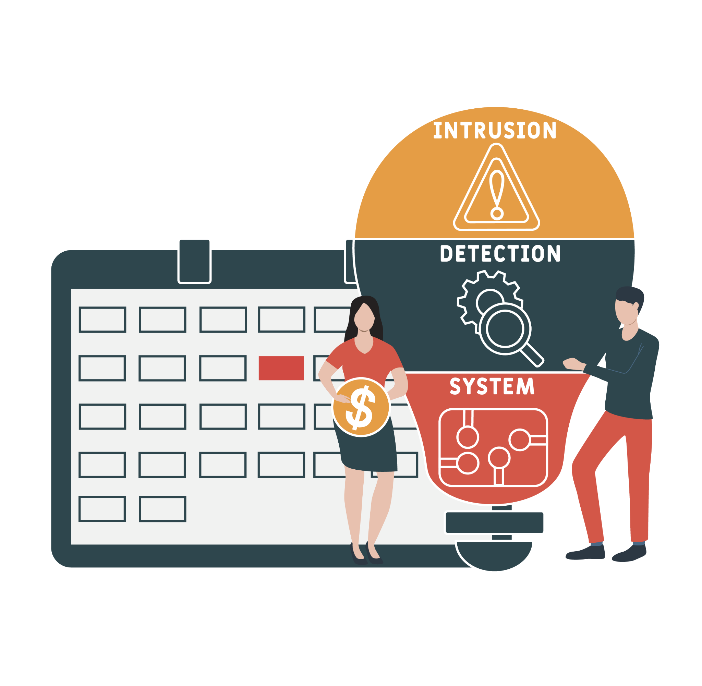
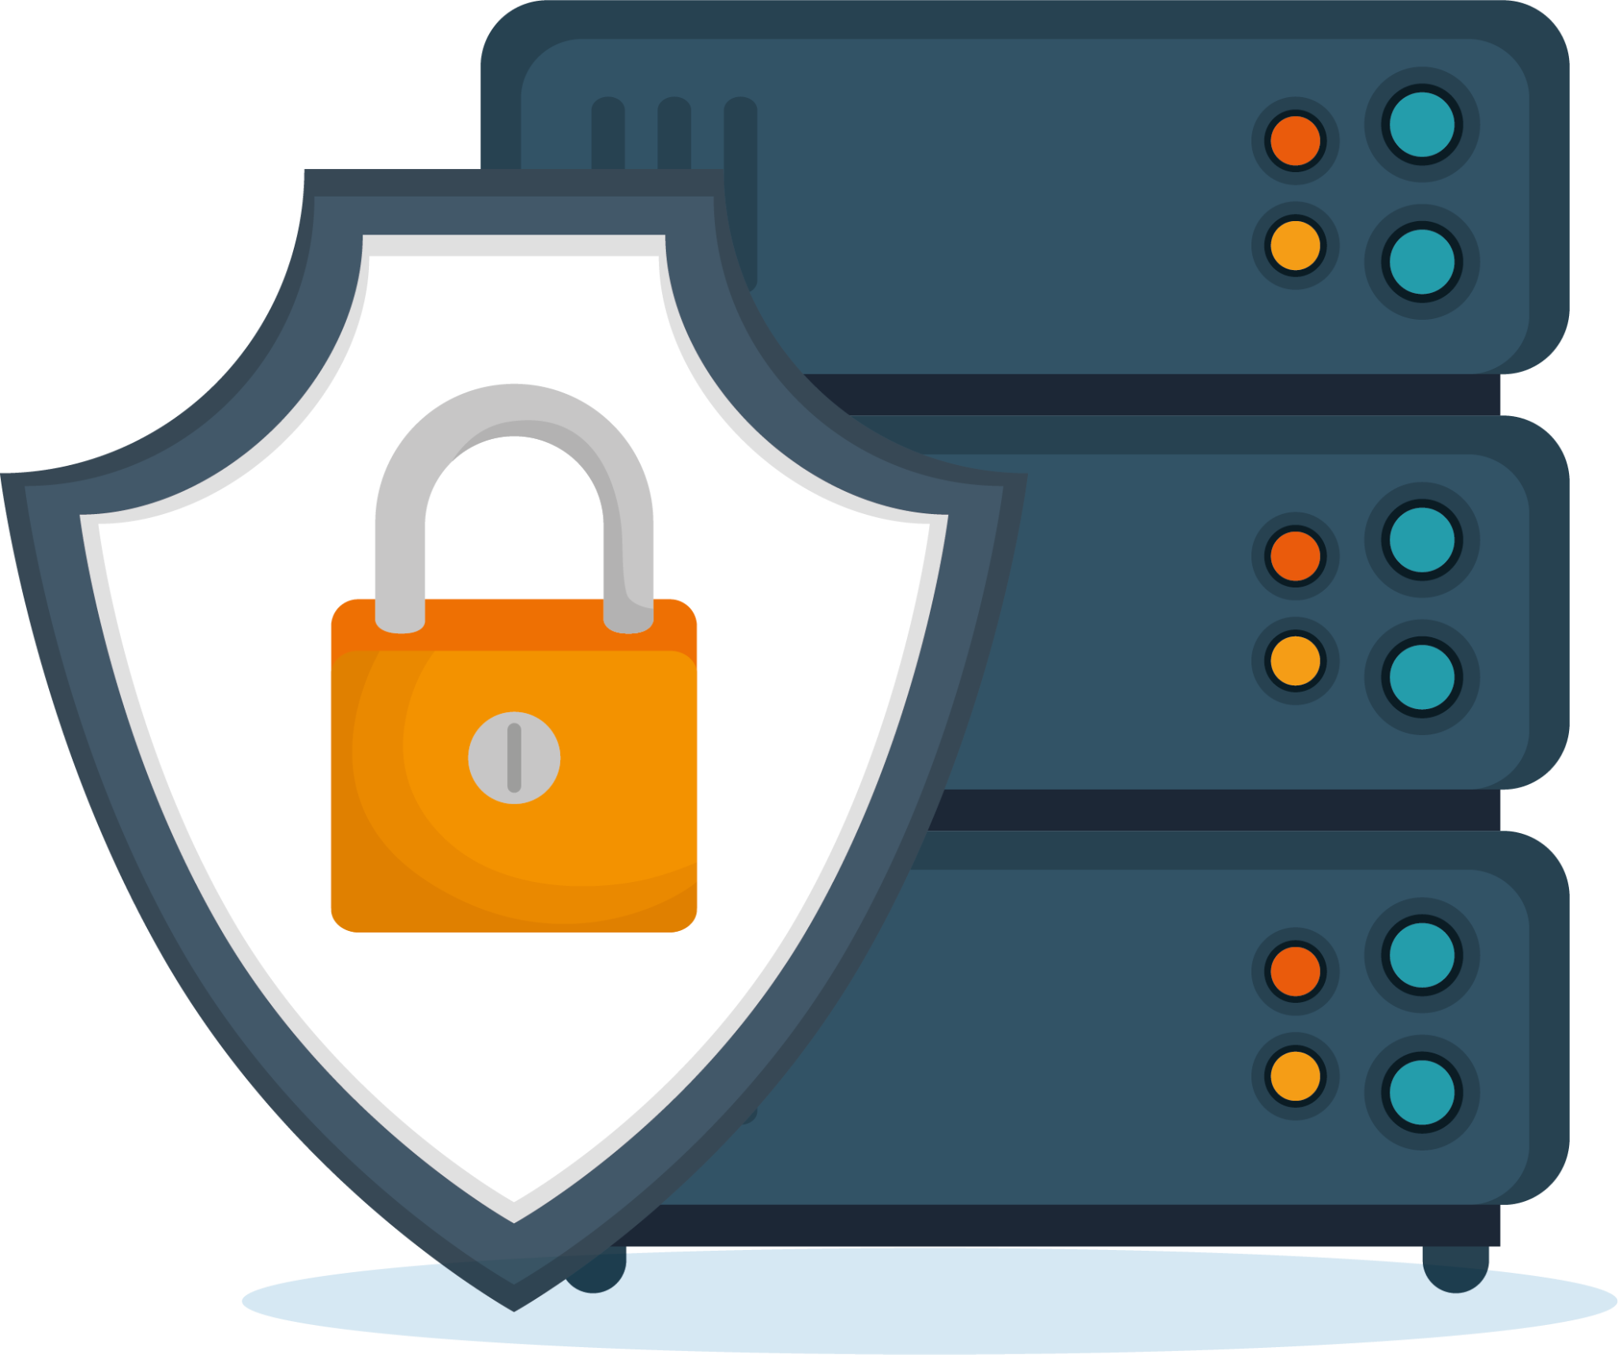

Control Types
Preventive
Detective
Deterrent
Notes:
Mention each type of Control Types

Slide 133

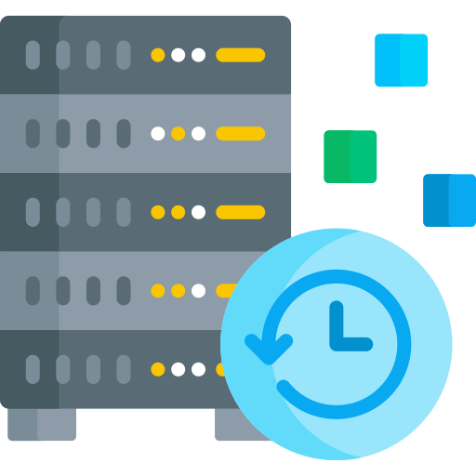

Control Types
Corrective
Recovery
Compensative
Notes:
Mention each type of Control Types

Slide 134
Preventive Control
Preventive controls are intended to stop an incident from occurring.
They operate before an attack can take place, eliminating or reducing the likelihood of a successful attack.
Examples include walls and locks, which stop people from entering an area in an unauthorized manner.
Notes:
Preventive or preventative controls are intended to stop an incident from occurring.
Preventative control operates before an attack can take place and eliminates or reduces the likelihood of a successful attack.
Walls and locks can stop people from entering an area in an unauthorized manner.
Other examples can include data leak prevention systems (DLP) and intrusion prevention systems (IPS).

Slide 135
Detective Control
Detective controls are intended to discover or detect unwanted or unauthorized activity.
These controls include security guards, logs, intrusion detection systems (IDS), and the review of outputs from a security information and event management (SIEM) system by the security team.
Notes:
Explain Detective controls with examples
Detective controls are intended to discover or detect unwanted or unauthorized activity.
These can include security guards, logs, intrusion detection systems (IDS), and the security team reviewing the outputs of a security information and event management (SIEM) system.

Slide 136
Deterrent Control
Deterrent controls are intended to discourage potential attackers.
These controls include warning signs, policies, NDAs, and legal penalties against trespassing or intrusion.
Notes:
Explain Deterrent controls with examples
Deterrent controls are intended to discourage a potential attacker.
These could include warning signs, policies, NDAs, and legal penalties against trespass or intrusion.

Slide 137
Corrective Control
Corrective controls are intended to correct problems resulting from a security incident.
They reduce or eliminate the opportunity for the unwanted event to recur.
Examples include using a fire extinguisher to put out a fire or patching a system to fix vulnerabilities.
Notes:
Explain Corrective controls with examples
Corrective controls are intended to correct any problems resulting from a security incident.
They reduce or eliminate the opportunity for the unwanted event to recur.
Examples are fire extinguisher to put off fire or patching a system to fix vulnerabilities.

Slide 138
Recovery Control
Recovery controls are intended to bring the environment back to regular operations.
These controls include backups and disaster recovery plans.
Notes:
Explain Recovery controls with examples

Slide 139


Control Selection
The selection of security controls will depend on the nature of the business, the complexity of the environment, and the value of the assets.
A security control must make good business sense, meaning it should be cost-effective, and its benefits must outweigh its costs.
Notes:
Explain control selection with example

Slide 140
Control Matrix
 | Preventive | Detective | Deterrent | Corrective | Recovery
Administrative | Separation of duties | Audit | Disciplinary policy | Employee disciplinary actions | Disaster recovery plan
Technical | Firewall | IDS | Warning banner at login | Vulnerability patches | Data backup
Physical | Walls, fences, gates | CCTV | Beware of Dog sign | Fire suppression systems | Disaster recovery site
Notes:
Discuss control matrix

Slide 141

Multiple Control Facilities
Controls can provide several functions, depending on their implementation and operation.
Surveillance cameras are considered deterrent controls because they discourage potential attackers from performing unauthorized actions.
They are considered detective controls because they identify and record security incidents.
They serve as compensating controls by providing an additional detection method for security guards.
Notes:
Control can provide several functionalities, depending on their implementation and operation.
Surveillance cameras can be considered a deterrent control since cameras discourage a potential attacker from doing an unauthorized action.
It is also considered a detective control. For example, when security guards monitor cameras or cameras are combined with motion-sensing capabilities triggering an alarm.
It is also a compensating control since it provides an additional detection method for security guards.

Slide 142

Risk Monitoring and Measurement
The risk environment is dynamic due to the organization's internal and external environments constantly changing.
Organizations should continuously monitor IT risks and controls, communicate findings to relevant stakeholders, and ensure the continued efficiency and effectiveness of the IT risk management strategy and its alignment with business objectives.
Notes:
Trainer Notes:
The risk environment is dynamic because the organization’s internal and external environments are constantly changing.
Organizations should continuously monitor and report on IT risk and controls to relevant stakeholders to ensure the continued efficiency and effectiveness of the IT risk
management strategy and its alignment to business objectives.

Slide 143
Risk Measurement
KRIs and KPIs can be used to measure, monitor, and report risk. The two are explained in detail below.
A key risk indicator (KRI) is a measure used in risk management to indicate the risk level of an activity.
By comparing an appropriate set of key risk indicators with defined thresholds, organizations receive early warnings when a risk approaches an unacceptable level.
Key risk indicator (KRI)
A key performance indicator (KPI) is used to measure how well a process is performing in terms of its stated goals.
KPIs are used to set benchmarks for risk management goals and monitor whether those goals are being met.
Key performance indicators (KPIs)
Notes:
Trainer Notes:
KRIs and KPIs can use used to measure, monitor and report risk.
Key Risk Indicator (KRI)
A key risk indicator (KRI) is a measure used in risk management to indicate how risky an activity is.
By comparing an appropriate set of key risk indicators with defined thresholds, organizations receives an early warning when a risk level approaches an unacceptable level.
Examples of KRI could include
The number of viruses detected
The number of critical assets with known vulnerabilities
The number of days to deactivate former employee credentials
Key Performance Indicators (KPIs)
A key performance indicator (KPI) is used to measure how well a process is performing in terms of its stated goal.
KPIs are used to set benchmarks for risk management goals and to monitor whether those goals are being attained.
Example of KPI could include
The number of servers that are fully patched and up to date
Percentage of employees undergone security awareness training

Slide 144



KPI and KRI
KPIs and KRIs are often used in conjunction with one another to measure performance and mitigate risk.
Users must understand the context to build the best measures for KPIs and KRIs.
KPIs and KRIs must be SMART metrics.
KPIs identify underperforming aspects, while KRIs provide early warnings of increased risk.
Notes:
KPI and KRI both must be SMART metrics.
KPIs identify underperforming aspects of the organizations and areas of the business that may require additional resources and attention, whereas KRIs provide early warnings of increased risk.
A hospital might have a KPI or KRI related to systems having proper redundancy to support medical operations during a crisis situation. That level of performance would not be appropriate to a university’s local area network. Understand the context in which you’re working to build the best measures for KPI and KRI.

Slide 145

Risk Reporting
Include information on current risk management capabilities, status, and trends in a risk report.
Document and report the results of the risk monitoring process to senior management regularly.
Trigger a report to senior management and reassess risk controls following significant security incidents or changes in risk.
Notes:
Trainer Notes:
A risk report includes information on current risk management capabilities and actual status and trends with regard to risk.
Results of the risk monitoring process need to documented and reported to the senior management on a regular basis.
A significant security incident or significant changes in risk should trigger a report to the senior management and reassessment of the risk controls.

Slide 146
Business Impact Analysis (BIA)
Business impact analysis is an important phase to achieve a comprehensive BCP (Business continuity planning) or DRP (Disaster recovery policy).
The business impact analysis
Determines the impact of disruption to the organization’s IT systems on business processes and functions.
Enables the BCP (Business continuity policy) or DR (Disaster recovery) project manager to plan requirements and priorities for IT contingencies by identifying and prioritizing critical IT systems and components.
Notes:
Trainer Notes:
According to NIST 800-34, business impact analysis is required to achieve a comprehensive BCP or DRP.
The Business Impact Analysis (BIA):
Is the formal method of determining the impact of disruption to the organization’s IT systems on the business and organization’s processes and functions
Enables the BCP or DR project manager to plan the requirements and priorities for IT contingencies by identifying and prioritizing critical IT systems and components

Slide 147
BIA: Goals
The three major goals of BIA are:
Criticality prioritization
Identifies and prioritizes every critical business unit process
Evaluates the impact of a disruptive event
Assigns a higher priority rating for recovery to time-critical business processes than to non-critical business processes
Downtime estimation
Estimates Maximum tolerable downtime (MTD) using the BIA
Determines the downtime required for the business to remain viable
Ensures non-recovery if the interruption of a critical process extends beyond the maximum tolerable downtime
Resource requirements
Estimates resource requirements
Allocates most resources to time-sensitive processes compared to less critical processes
Notes:
Trainer Notes:
The major goals of BIA are:
Criticality Prioritization
Identification and prioritization of every critical business unit process
Evaluation of the impact of a disruptive event
Time-critical business processes require higher priority rating for recovery than non–critical business processes
2. Downtime Estimation:
Estimating Maximum Tolerable Downtime (MTD) using the BIA
The downtime required for the business to remain viable
Non-recovery, if the interruption of critical process extends the maximum tolerable downtime
3. Resource Requirements
Estimating resource requirements
Most resources allocated to time sensitive processes as compared to less critical processes

Slide 148
BIA: Steps
The steps of a BIA are outlined here:
Selects individuals to interview for data gathering
Identifies the resources on which the critical business functions depend
Calculates risk for each business function
Creates and uses data gathering techniques
Calculates the longevity of these functions without the identified resources
Gathers, analyzes, and interprets qualitative and quantitative impact information
Identifies the company's critical business functions
Identifies vulnerabilities and threats to these functions
Documents findings and reports to management
Notes:
Trainer Notes:
Explain the steps given on the slide.

Slide 149


BIA Steps: Business Unit Level
For each major business unit within the organization, the following steps will be performed:
Identifies business components or activities that, if disrupted or unavailable, could jeopardize the company's operations
Determines required Maximum tolerable downtime
Notes:
Trainer Notes:
For each major business unit within the organization, the following steps will be performed:
Identify business components or activities that, if disrupted or unavailable, could jeopardize the company’s operations
Determine required Maximum Tolerable Downtime (MTD)

Slide 150
Maximum Tolerable Downtime (MTD)
Maximum Tolerable Downtime is:
The maximum period during which the organization’s key processes and functions are unavailable, leading to significant losses.
The duration measured in minutes, hours, days, or longer, depending on the nature of the business.
The timeline revised several times during the course of a project.
Notes:
Trainer Notes:
Maximum Tolerable Downtime (MTD) is:
The maximum period for which the organization’s key processes and functions are unavailable, after which the organization would suffer significant losses
Revised several times during the course of a project
Measured in minutes, hours, days, or longer, depending on the nature of the business

Slide 151
Failure and Recovery Metrics
A number of metrics are used to quantify the frequency of system failures.
Recovery point objective
Level of data, work loss, or system inaccessibility resulting from a disruptive event
Expressed in units of time
Recovery time objective
Maximum time allowed to recover business or IT systems
Expressed in units of time such as minutes, hours, or days
Notes:
Trainer Notes:
A number of metrics are used to quantify the frequency of system failures.
Recovery Point Objective:
Level of data, work loss, or system inaccessibility resulting from a disruptive event
Usually expressed in units of time
Recovery Time Objective:
The maximum time allowed to recover business or IT systems
Expressed in units of time such as minutes, hours, or days
Work Recovery Time:
The time required to configure a recovered system
Consists of the system’s recovery time and the work recovery time

Slide 152
Failure and Recovery Metrics
Mean time between failures
Predicted elapsed time between inherent failures of a system during operation
Calculated elapsed time as the arithmetic mean time between failures of a system
Mean time to repair
Duration to recover a specific failed system
Total corrective maintenance time divided by the total number of corrective maintenance actions during a given period
Minimum operating requirements
Minimum environmental and connectivity requirements for computer equipment to operate
Importance of documentation for each IT critical asset
Notes:
Trainer Notes:
Mean Time between Failures:
The predicted elapsed time between inherent failures of a system during operation
Calculated as the arithmetic mean time between failures of a system
Mean Time to Repair:
The duration to recover a specific failed system
The total corrective maintenance time divided by the total number of corrective maintenance actions during a given period
Minimum Operating Requirements:
The minimum environmental and connectivity requirements for a computer equipment to operate
Documentation is important for each IT critical asset

Slide 153
Third-Party Risk Assessment and Management

Slide 154
Third-Party Vendor Management
Engages a third-party vendor, a company not under direct business control, in any business arrangement, by contract or otherwise
Outsources business processes to third-party companies
Outsources systems, business processes, and data processing to service providers to focus on core competencies, reduce costs, and quickly deploy new applications
Manages third-party risk with a comprehensive plan to identify and mitigate potential business uncertainties and legal liabilities
Notes:
Trainer Notes:
A third party is a company that is not under direct business control of the organization that engages it. A third-party relationship is any business arrangement between a company and another entity, by contract or otherwise.
Outsourcing is the subcontracting of a business process to a third-party company.
Organizations are increasingly outsourcing systems, business processes, and data processing to service providers in an effort to focus on core competencies, reduce costs, and more quickly deploy new application functionality.
Third-party risk management is a comprehensive plan for identifying and mitigating potential business uncertainties and legal liabilities regarding the hiring of third-party services.

Slide 155
Types of Third-Party Relationships
Insourced
Outsourced
Hybrid
Activities performed by the organization's own staff.
Activities performed by the vendor's staff.
Activities performed jointly by staff from both the organization and the vendor.
Onsite
Offsite
Offshore
Activities performed by staff working onsite in the IT department.
Staff working from remote locations in the same geographical area.
Staff working from remote locations in different geographical areas.
Notes:
Lets understand different types of Third Party relationship
Insourced-Activities performed by the organization's own staff
Outsourced-Activities performed by the vendor's staff
Hybrid-Activities performed jointly by staff from both the organization and the vendor
Onsite-Staff working onsite in the IT department
Offsite-Staff working from remote locations in the same geographical area
Offshore-

Slide 156
Third-Party Risks
Information security or data privacy
Business continuity
Lacks sufficient experience and controls to protect the company's and customer's information from unauthorized access, disclosure, modification, or destruction
Cannot continuously maintain services due to business disruption (e.g., ineffective redundancy procedures)
Financial viability
Is not financially secure enough to continue providing services at acceptable levels
Notes:
Trainer Notes:
Let’s walk through the third-party risks.
First is, Information Security or Data Privacy: Third party has insufficient experience and controls to protect the company's and customer's information from unauthorized access, disclosure, modification, or destruction.
Second risk is Business Continuity: Third party cannot continuously maintain its services due to business disruption (e.g., ineffective redundancy procedures).
The third risk is Financial Viability: Third party is not financially secure to continue to provide you services at acceptable levels.

Slide 157
Third-Party Risks
Contract compliance
Legal or regulatory
Fails to align products, services, or systems with your policies, procedures, applicable laws, regulations, and ethical standards
Lacks necessary licenses and expertise to ensure compliance with domestic and international laws and regulations
Notes:
Trainer Notes:
The fourth risk is Contract Compliance: Third party products, services, or systems are not consistent with your policies and procedures, applicable laws, regulations, and ethical standards.
And the fifth risk is Legal or Regulatory: Third party does not possess the necessary licenses to operate. It lacks the expertise to enable the company to remain compliant with domestic and international laws and regulations.

Slide 158
Vendor Assessment

Slide 159

Vendor Assessment
Vendor assessment
Conducts a thorough background check to evaluate potential suppliers' due diligence, competence, and dependability, safeguarding business interests and maintaining quality control
Evaluates a potential supplier's capabilities, reliability, and suitability to meet a company's needs and determine their trustworthiness as a partner
Notes:
Trainer Notes:
A vendor assessment is a thorough background check for potential suppliers to evaluate their due diligence, competence, and dependability for safeguarding business interests and maintaining quality control..
It is the process of evaluating a potential supplier's capabilities and suitability to meet a company's needs.
It involves deep diving into the vendor's background to assess their reliability and trustworthiness as a partner.

Slide 160




Importance of Vendor Assessment
Reduced risk: Identifies potential risks associated with a vendor, such as financial instability, security vulnerabilities, or poor performance history
Improved decision-making: Enables companies to make more informed business decisions through objective evaluation of vendors against defined criteria
Ensured compliance: Ensures that vendors meet regulatory requirements or industry standards relevant to your business
Stronger vendor relationships: Opens communication channels and establishes clear expectations with the vendor from the outset
Notes:
Trainer Notes
Lets understand the importance of Vendor Assessment
Reduced Risk: A thorough assessment helps identify potential risks associated with a vendor, such as financial instability, security vulnerabilities, or poor performance history.
Improved Decision-Making: By objectively evaluating vendors against defined criteria, companies can make more informed decisions about who to do business with.
Ensured Compliance: Vendor assessments can help ensure that vendors meet regulatory requirements or industry standards relevant to your business.
Stronger Vendor Relationships: The assessment process can open communication channels and establish clear expectations between you and the vendor from the outset.

Slide 161


Vendor Assessment Activities
Right to audit clause
Independent assessments
Evidence of internal audits
Notes:
Mention each type of Vendor Assessment activities

Slide 162



Vendor Assessment Activities
Supply chain analysis
Penetration testing
Financial ability analysis
Notes:
Mention each type of Vendor Assessment activities

Slide 163
Vendor Assessment Activities
Right to audit
Includes a right-to-audit clause in vendor agreements, granting organizations the ability to conduct on-the-spot audits of vendors' systems and processes to verify compliance with standards and regulations
Independent assessments
Conducts third-party audits to provide an unbiased evaluation of a vendor’s operations, security practices, and compliance status, offering an impartial perspective on the vendor’s risk profile
Evidence of internal audits
Reviews internal audit reports to evaluate vendors' controls and risk management, enhancing decision-making and operational resilience
Notes:
Vendor Assessment Activities
Right to Audit-A right-to-audit clause is essential in vendor agreements, granting organizations the right to conduct on-the-spot audits of vendors' systems and processes to verify compliance with standards and regulations.
Evidence of Internal Audits-Studying internal audit reports helps organizations evaluate vendors' controls and risk management, enabling better decision-making and improved operational resilience.
Independent Assessments-Independent assessments, often conducted by third-party auditors, offer an unbiased evaluation of a vendor’s operations, security practices, and compliance status. These assessments provide organizations with an impartial perspective on the vendor’s risk profile, supporting the validation

Slide 164
Vendor Assessment Activities
Penetration testing
Conducts penetration testing, or pen testing, to run simulated cyberattacks, identify and understand system vulnerabilities, and assess how well the vendor system can protect against attacks
Supply chain analysis
Understands a vendor's supply chain to anticipate and manage potential disruptions and risks effectively
Financial ability analysis
Assesses the vendor's financial health to ensure they can reliably fulfill their obligations and prevent the company from going out of business during service delivery
Notes:
Vendor Assessment Activities
Supply Chain Analysis-
Understanding a vendor's supply chain is essential for anticipating and managing potential disruptions and risks effectively.
Financial Abiliities-Assessing the vendor's financial health to ensure they can reliably fulfil their obligations. It is to ensure that the company don’t go out of business in the middle of services
Penetration Testing-Penetration testing, or pen testing, involves running simulated cyberattacks to identify and understand system vulnerabilities and assess how well the vendor system can protect against attacks.

Slide 165
Vendor Selection

Slide 166

Vendor Selection
Vendor selection
Involves thorough assessments and evaluations to ensure vendors align with the organization’s goals and operational standards
Aims to minimize risks by choosing providers based on needs, goals, and risk tolerance, considering quality, reliability, and security, not just cost-effectiveness
Notes:
Trainer Notes:
Vendor selection is a thorough process involving assessments and evaluations to ensure vendors align with the organization’s goals and operational standards.
It aims to minimize risks and involves choosing providers based on needs, goals, and risk tolerance, considering quality, reliability, and security, not just cost-effectiveness.

Slide 167


Activities for Vendor Selection
Activities for vendor selection
Identifying conflict of interests
Conducting due diligence
Notes:
Mention each type of Vendor Assessment activities

Slide 168
Due Diligence
Refers to the comprehensive appraisal of a vendor’s business practices, financial stability, reputation, and compliance with relevant laws and regulations
Is an essential step in vendor selection to ensure that the organization partners with a reliable and competent third party
Involves cybersecurity professionals to ensure that the organization follows industry best practices
Notes:
Due Diligence
refers to the comprehensive appraisal of a vendor’s business practices, financial stability, reputation, and compliance with relevant laws and regulations. It’s an essential step in vendor selection to ensure that the organization partners with a reliable and competent third party. Cybersecurity professionals are occasionally brought in during a due diligence review to ensure that the organization follows industry best practices.

Slide 169

Activities of Due Diligence
Activities performed as part of due diligence
Financial audits: Reviews the vendor’s financial statements to assess stability
Security assessments: Evaluates the vendor’s cybersecurity measures and protocols
Legal checks: Verifies compliance with industry-specific laws and regulations
Notes:
Trainer Notes:
he due diligence process often includes, but is not limited to, the following activities:
Financial audits: Review of the vendor’s financial statements to assess stability
Legal checks: Verification of compliance with industry-specific laws and regulations
Security assessments: Evaluation of the vendor’s cybersecurity measures and protocols

Slide 170

Conflict of Interests
Occurs when a vendor's personal or professional interests could interfere with acting in the best interests of your organization
Is crucial to identify and manage these conflicts to maintain fairness in the vendor selection process
Requires evaluating existing relationships between decision-makers and vendors, and addressing potential undue influences to uphold transparency
Notes:
A conflict of interest occurs when a vendor's personal or professional interests could interfere with acting in the best interests of your organization.
It's crucial to identify and manage these conflicts to maintain fairness in the vendor selection process.
Organizations must evaluate existing relationships between decision-makers and vendors and address potential undue influences to uphold transparency

Slide 171

Factors to Look for in Conflict of Interest
Activities that may indicate a conflict of interest.
Financial conflicts: These conflicts occur when a decision maker in an organization has a financial stake in the vendor company.
Relational conflicts: These conflicts occur when personal relationships could influence vendor selection.
Competitive conflicts: These conflicts occur when a vendor may also be a competitor in some aspects of the business.
Notes:
Trainer Notes:
Conflicts of interest can manifest in various ways, such as:
Financial conflicts: These conflicts occur when a decision maker in an organization has a financial stake in the vendor company.
Relational conflicts: These conflicts occur when personal relationships could influence vendor selection.
Competitive conflicts: These conflicts occur when a vendor may also be a competitor in some aspects of the business.

Slide 172
Agreement Types

Slide 173

Agreement
These are the legal backbone of vendor relationships, outlining responsibilities, expectations, and boundaries.
It is crucial to understand different agreement types to establish clear contractual foundations, reduce vulnerabilities, and ensure adequate protection.
Notes:
Agreements:
In third-party risk assessment and management, the agreements you enter into significantly impact your organization's risk level.
These agreements are the legal backbone of vendor relationships, outlining responsibilities, expectations, and boundaries.
Understanding different agreement types is crucial for clear contractual foundations, mitigating vulnerabilities, and ensuring adequate protection
refers to the comprehensive appraisal of a vendor’s business practices, financial stability, reputation, and compliance with relevant laws and regulations. It’s an essential step in vendor selection to ensure that the organization partners with a reliable and competent third party. Cybersecurity professionals are occasionally brought in during a due diligence review to ensure that the organization follows industry best practices.

Slide 174

Types of Agreements: SLA
An SLA, which stands for Service Level Agreement, is a formal document that outlines the agreed-upon level of service expected between a service provider and a customer.
It is essentially a contract that defines the responsibilities of both parties to ensure clear expectations and a smooth working relationship.
Notes:
Agreements
In third-party risk assessment and management, the agreements you enter into significantly impact your organization's risk level.
These agreements are the legal backbone of vendor relationships, outlining responsibilities, expectations, and boundaries.
Understanding different agreement types is crucial for clear contractual foundations, mitigating vulnerabilities, and ensuring adequate protection
refers to the comprehensive appraisal of a vendor’s business practices, financial stability, reputation, and compliance with relevant laws and regulations. It’s an essential step in vendor selection to ensure that the organization partners with a reliable and competent third party. Cybersecurity professionals are occasionally brought in during a due diligence review to ensure that the organization follows industry best practices.

Slide 175
Components of SLA
Service provided
Performance standards
Responsibilities
A clear description of the services that the provider will deliver, which can range from IT support and network uptime to cloud storage capacity and software functionality.
The expected level of service quality may include uptime percentages, response times for tickets, and data availability guarantees..
The breakdown of responsibilities: the provider outlines their tasks, and the customer outlines their responsibilities for effective use
Measurement and reporting
Remedies
Service exclusions
Methods for measuring performance against the agreed-upon standards. This might involve generating reports on uptime, response times, or other relevant metrics
Actions that will be taken if the service provider fails to meet the agreed-upon standards. This could involve service credits, discounts, or even termination of the agreement in extreme cases
Clearly states any services or functionalities that are not included in the agreement to avoid confusion.
Notes:
Components of SLA
Services Provided: A clear description of the services the provider will deliver. This could be anything from IT support and network uptime to cloud storage capacity and software functionality.Performance Standards: Specific metrics that define the expected level of service quality. These might include uptime percentages for a website, response times for customer support tickets, or data availability guarantees.Responsibilities: A breakdown of what each party is responsible for. The provider outlines what they will do to deliver the service, and the customer outlines their responsibilities for using the service effectively.Measurement and Reporting: Methods for measuring performance against the agreed-upon standards. This might involve generating reports on uptime, response times, or other relevant metrics.Remedies: Actions that will be taken if the service provider fails to meet the agreed-upon standards. This could involve service credits, discounts, or even termination of the agreement in extreme cases

Slide 176
Other Types of Agreements
Business Partnership
Agreement
The Business Partnership Agreement (BPA) is a legal document for two companies entering a profit venture. It outlines contributions, rights, responsibilities, operational rules, decision-making, profit distribution, and termination terms.
Memorandum of Understanding
An MOU is a formal
acknowledgment of a mutual agreement between two or more parties. It reflects a serious commitment from all involved parties but generally lacks the enforceability of a legal contract. It serves primarily as a statement of intent.
Memorandum of
Agreement
An MOA is a legally binding document that outlines the terms, conditions, roles, and responsibilities of all parties involved. It aims to clarify expectations, prevent disputes, and ensure mutual cooperation.
Notes:
Agreements
Business Partnership Agreement (BPA): A BPA is used between two companies who want to participate in a business venture to make a profit. It sets out how much each partner should contribute, their rights and responsibilities, the rules for the day-to-day running of the business, who makes the decisions, and how the profits are shared. It also establishes rules for termination of the partnership, either at a given point in time or if one of the partners dies or is otherwise unable or unwilling to continue their partnership.
Memorandum of Agreement (MOA): An MOA is legally binding. It meticulously outlines the terms and conditions and detailed roles and responsibilities of the parties involved. The MOA serves to clarify the expectations and obligations of each party to avoid disputes and ensure mutual understanding and cooperation.
Memorandum of Understanding (MOU): An MOU is a formal acknowledgment of a mutual agreement between two or more parties. It is more substantial than an informal agreement, reflecting a serious commitment from all involved parties, but generally lacks the binding enforceability of a legal contract. It serves primarily as a statement of intent.
Right to Audit-A right-to-audit clause is essential in vendor agreements, granting organizations the right to conduct on-the-spot audits of vendors' systems and processes to verify compliance with standards and regulations.
Evidence of Internal Audits-Studying internal audit reports helps organizations evaluate vendors' controls and risk management, enabling better decision-making and improved operational resilience.
Independent Assessments-Independent assessments, often conducted by third-party auditors, offer an unbiased evaluation of a vendor’s operations, security practices, and compliance status. These assessments provide organizations with an impartial perspective on the vendor’s risk profile, supporting the validation

Slide 177
Other Types of Agreements
Non-Disclosure
Agreement
An NDA is a legal contract where an employee or business partner agrees not to disclose trade secrets without authorization, preventing sharing with competitors.
Master Service
Agreement
The Master Services Agreement (MSA) outlines general terms and conditions governing the contractual relationship and covers payment terms, dispute resolution, intellectual property rights, confidentiality, and liability provisions.
Statement of Work/Work Order
An MSA outlines partnership terms, while a WO or SOW focuses on specific tasks. The SOW provides detailed work breakdown, timelines, deliverables, and compensation.
Notes:
Master Service Agreement (MSA): The MSA articulates the general terms and conditions governing a contractual relationship between the involved entities. It typically addresses aspects such as payment terms, dispute resolution mechanisms, intellectual property rights, confidentiality clauses, and liability provisions.
Work Order (WO)/Statement of Work (SOW): While an MSA outlines the terms and conditions of a contracted partnership, a WO or SOW looks at the specifics of individual tasks or projects. The SOW typically provides a detailed breakdown of the work to be performed, the timelines for completion, the expected deliverables, and the agreed-upon compensation.
Non-Disclosure Agreement (NDA): An NDA is a legally binding contract made between an organization and an employee or a business partner, in which the signee promises not to disclose trade secrets to others without proper authorization. The reason for this is to stop trade secrets or proprietary information from being sold on to competitors.

Slide 178
Vendor Monitoring, Questionnaires and Rules of Engagement

Slide 179


Vendor Monitoring
Vendor monitoring is a pivotal aspect of third-party risk management and provides a systematic approach to evaluating and overseeing vendors’ performance and compliance.
It ensures that vendors adhere to contractual obligations, maintain high-quality standards, and comply with applicable regulations and industry best practices.
Notes:
Explain Vendor Monitoring
Vendor monitoring is a pivotal aspect of third-party risk management and provides a systematic approach to evaluating and overseeing vendors’ performance and compliance.
It ensures that vendors adhere to contractual obligations, maintain high-quality standards, and comply with applicable regulations and industry best practices.
This helps organisations identify and address discrepancies and non-compliance early on.

Slide 180
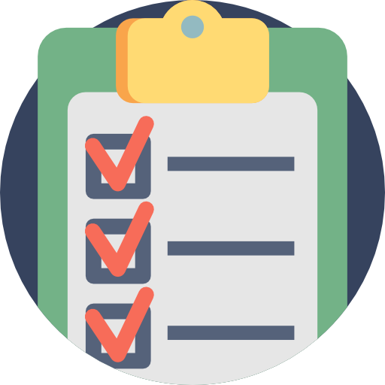
Questionnaires
Questionnaires for vendor monitoring are designed to gather detailed information about a vendor’s operations, including financial stability, regulatory compliance, performance history, and security measures.
The insights gathered help assess risks and ensure vendors align with organizational values and goals.
Notes:
Explain Questionnaires
Questionnaires for vendor monitoring are designed to gather detailed information about a vendor’s operations, including financial stability, regulatory compliance, performance history, and security measures.
The insights gathered help assess risks and ensure vendors align with organizational values and goals.
In the financial sector, a questionnaire may inquire about a vendor's data encryption, multifactor authentication, and incident response practices. While the answers are informative, the real value often comes from follow-up discussions.

Slide 181

Rules of Engagement
The term "rules of engagement" refers to the agreed-upon guidelines for activities and interactions between an organization and a vendor.
It covers issue resolution, service/product changes, and reporting security vulnerabilities. Clear rules reduce ambiguity and conflicts, which is crucial in areas like cybersecurity, where delays can be critical.
Notes:
The term "rules of engagement" refers to the agreed-upon guidelines for activities and interactions between an organisation and a vendor.
It covers issue resolution, service/product changes, and reporting security vulnerabilities. Clear rules reduce ambiguity and conflicts, which is crucial in areas like cybersecurity, where delays can be critical.

Slide 182
Considerations for Rules of Engagement
Clarity and alignment: Rules of engagement provide clarity by clearly defining the roles and responsibilities of both the organization and the vendor.
Conflict prevention: Establishing rules in advance helps organizations address potential sources of disagreement, reducing the likelihood of disputes..
Efficiency: Clear rules make processes more efficient, streamlining communication and reducing delays.
Notes:
Trainer Notes:
A risk report includes information on current risk management capabilities and actual status and trends with regard to risk.
Results of the risk monitoring process need to documented and reported to the senior management on a regular basis.
A significant security incident or significant changes in risk should trigger a report to the senior management and reassessment of the risk controls.

Slide 183
Summarize Elements of Effective Security Compliance

Slide 184
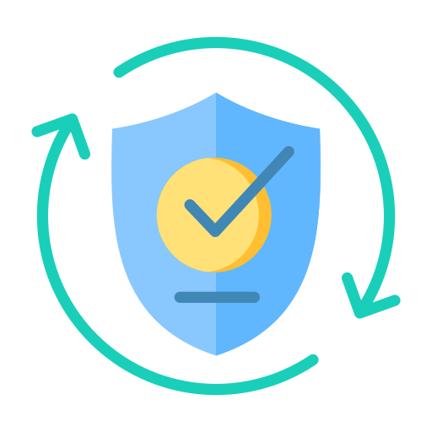
What is Compliance?
In IT security and data privacy, compliance refers to adhering to rules and regulations established to protect information assets, systems, and user privacy.
It refers to the state of being by a set of rules and regulations established to safeguard information assets, systems, and user privacy
Notes:
In IT security and data privacy, compliance refers to adhering to rules and regulations established to protect information assets, systems, and user privacy.
It refers to the state of being by a set of rules and regulations established to safeguard information assets, systems, and user privacy

Slide 185

Compliance Reporting
It is a critical component that ensures organizations adhere to regulatory standards, industry best practices, and internal policies.
These reports serve as a roadmap to assess an organization’s security posture, identify vulnerabilities, and drive continuous improvement.
Notes:
Compliance reporting is a critical component that ensures organisations adhere to regulatory standards, industry best practices, and internal policies.
These reports serve as a roadmap to assess an organization’s security posture, identify vulnerabilities, and drive continuous improvement.
It serves dual functions by providing stakeholders with actionable insights through systematically documenting metrics, such as the number of thwarted unauthorised access attempts or the percentage of employees completing mandatory security training.

Slide 186
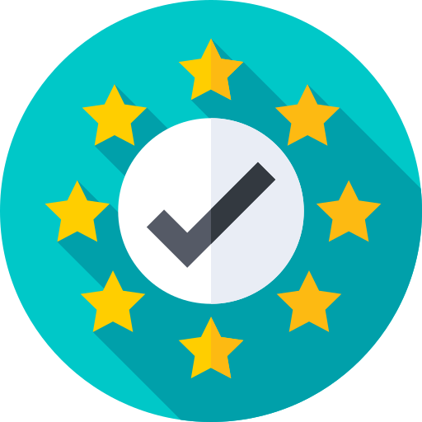
Example of Compliance Reporting
FCPA compliance: This report evaluates due diligence programs and internal accounting controls to prevent corrupt practices and ensure compliance with the Foreign Corrupt Practices Act.
PCI DSS Compliance: This report summarizes the documentation and testing of security controls, essential for businesses handling credit card transactions.
HIPAA or GDPR compliance: A HIPAA compliance report involves measures for safeguarding patient health information, and a GDPR compliance report includes protocols for protecting personal data and privacy rights within the European Union
Notes:
Trainer Notes:
FCPA compliance: This report reviews due diligence programs or internal accounting controls and typically assesses the effectiveness of measures taken to prevent corrupt practices and ensure adherence to the Foreign Corrupt Practices Act.
PCI DSS compliance: This report, which summarizes the documentation and testing of security controls, is essential for businesses handling credit card transactions. This report demonstrates adherence to the Payment Card Industry Data Security Standard by detailing how customer payment information is protected.
HIPAA or GDPR compliance: A HIPAA compliance report involves measures for safeguarding patient health information, and a GDPR compliance report includes protocols for protecting personal data and privacy rights within the European Union.

Slide 187
Internal and External Reporting
Internal Reporting
External Reporting
External compliance reporting focuses on demonstrating an organization’s adherence to external standards, regulations, and industry-specific requirements.
These reports are usually formatted according to specific guidelines and are submitted to regulatory bodies, third-party auditors, or industry-specific organizations.
External reporting is critical. Errors can result in fines or legal action. For example, a financial institution misreporting its capital ratios could face severe repercussions.
Internal compliance reporting involves the assessment and measurement of an organization’s adherence to its own security policies, standards, and procedures.
Internal compliance reporting involves systematic documentation, often facilitated through internal audits conducted by an in-house team.
The findings from these reports are actionable data, allowing immediate resource allocation for updates or staff retraining.
Notes:
Trainer Notes:
Internal compliance reporting involves systematic documentation that is often facilitated through internal audits conducted by an in-house team. Such an audit assesses the effectiveness of various controls, such as firewalls and data access policies. The findings from these internal reports are not mere records; they are actionable data. For instance, if an audit reveals outdated data encryption protocols, the organization can immediately allocate resources to update these protocols or initiate staff retraining.

Slide 188
Consequences of Noncompliance

Slide 189

Consequences of Noncompliance
Noncompliance with regulations, standards, or internal policies can have severe repercussions for an organization.
Consequences vary depending on the specific regulation or standard violated and the industry in which the organization operates.
Notes:
Non-compliance with regulations, standards, or internal policies can have severe repercussions for an organization.
It's crucial to understand that the consequences of non-compliance can vary depending on the specific regulation or standard violated and the industry in which the organization operates.

Slide 190
Consequences of Noncompliance
Fines
Sanctions
Reputational damages
Involves restricted access to sensitive data or networks until compliance is achieved
Imposes limitations on electronically transmitting patient records for non-compliant healthcare providers
Requires organizations to review cybersecurity protocols, enhance data encryption, enforce stricter access controls, and conduct regular cybersecurity audits to lift sanctions
Occurs when an organization's public image and credibility are negatively impacted due to non-compliance with regulations or standards, often seen after incidents like data breaches
Erodes trust in the organization's ability to safeguard data, leading to long-lasting impacts on business operations
Cybersecurity fines are imposed for reasons such as data breaches or unauthorized data access.
GDPR fines can reach €20 million or 4% of a company’s annual global turnover.
Systemic failures in cybersecurity measures may result in fines, requiring updates to infrastructure and training programs.
Notes:
Impact of Non Complainces
Fines-Fines are monetary penalties and often the most immediate and tangible consequence of non-compliance. In cybersecurity, fines can be levied for various reasons, such as for data breaches, unauthorized data access, or failure to report incidents in a timely manner. For instance, under GDPR, fines can reach €20 million (about $21 million) or 4% of a company’s annual global turnover, whichever is higher. A fine is a financial burden and a red flag indicating systemic failures in cybersecurity measures
Sanctions-Sanctions can include restrictions or limitations imposed on an organization. In cybersecurity, sanctions could mean restricted access to sensitive data or networks until compliance is achieved. For example, a healthcare provider found to be non-compliant with HIPAA may face sanctions that limit its ability to transmit patient records electronically
Reputational Damage-Reputational damage refers to negative impact on an organization’s public image and credibility due to non-compliance with regulations or standards and often manifests after an incident like a data breach. The damage to an organization’s reputation due to non-compliance can have long-lasting impacts on its business operations. For example, when a data breach occurs, customers and partners may lose faith in the organization’s ability to safeguard data. How often do you think less of a company after you hear that it has suffered a data breach? This loss of trust can lead to a decline in customer engagement, reduced revenue, and even the withdrawal of investors

Slide 191
Consequences of Noncompliance
Loss of licenses
Contractual impact
Additional consequences
Results in losing a license to operate, a severe consequence for organizations often due to cybersecurity lapses
Leads to financial institutions losing their license if they fail cybersecurity audits, effectively shutting down the business
Requires compliance with industry-specific cybersecurity regulations to prevent such outcomes
Refers to the negative effects on existing agreements and future business relationships due to an organization’s failure to comply with legal, regulatory, or agreed-upon standards
Leads to severe repercussions, such as contract termination and legal disputes
Results in contract termination if the cybersecurity standards outlined in a service-level agreement (SLA) are not met
Loss of competitive advantage: A strong security posture is becoming a differentiator in many sectors. Noncompliance can put organizations at a disadvantage compared to competitors who prioritize information security.
Damage to employee morale: Security incidents and data breaches can negatively impact employee morale and trust in leadership.
Notes:
Impact of Non Complainces
Loss of License-Losing a license to operate is one of the most severe consequences an organization can face, and in many cases, it can occur due to lapses in cybersecurity. An organization in a regulated industry that loses its license is prohibited from legally operating. For example, a financial institution that fails multiple cybersecurity audits could lose its operating license, which would effectively shut down the business
Contractual Impact-Contractual impact refers to the negative consequences on existing agreements and future business relationships resulting from an organization's failure to comply with legal, regulatory, or agreed-upon standards. Non-compliance can lead to contract termination and legal disputes. In cybersecurity, failure to meet security standards outlined in a service-level agreement (SLA) could result in contract termination, which could be devastating after investing significant time in vendor selection processes.

Slide 192
Compliance Monitoring

Slide 193

Compliance Monitoring
Involves assessing an organization's adherence to regulatory requirements, industry standards, and internal policies
Includes systematically observing, reviewing, and analyzing organizational activities to identify potential compliance risks and ensure necessary corrective actions are taken
Notes:
Compliance Monitoring:
Compliance monitoring is the ongoing process of assessing an organization's adherence to regulatory requirements, industry standards, and internal policies. It involves systematically observing, reviewing, and analyzing organizational activities to identify potential compliance risks and ensure necessary corrective actions are taken.

Slide 194
Compliance Monitoring Process
Due diligence
Due care
Involves a meticulous examination of an organization’s processes, practices, and policies to ensure alignment with regulatory requirements as part of effective compliance monitoring
Encompasses proactive efforts to identify vulnerabilities and weaknesses through comprehensive risk assessments and ongoing evaluations to maintain a strong security posture
Involves the ongoing practice of maintaining established systems or processes, including actions taken to apply information gathered during the due diligence phase
Includes continually updating security protocols, conducting regular audits, and ensuring all staff are trained in security best practices
Notes:
Due Diligence-Effective compliance monitoring begins with due diligence, which involves a meticulous examination of an organization’s processes, practices, and policies to ensure alignment with regulatory requirements. Due diligence is a proactive effort to identify vulnerabilities and weaknesses, including comprehensive risk assessments and ongoing evaluations to maintain a strong security posture.
Due Care-Due care is the ongoing practice of maintaining a system or process that has already been established. Due care includes the actions taken to apply the information gathered during the due diligence phase. It means continually updating security protocols, conducting regular audits, and ensuring all staff are trained in security best practices).

Slide 195
Compliance Monitoring Process
Internal compliance monitoring
External compliance monitoring
Internal compliance monitoring ensures adherence to laws, regulations, and policies within an organization. It includes internal audits, routine checks, vulnerability scans, penetration tests, and reviews of access controls
Compliance teams regularly audit server security configurations using specialized software and manual log reviews.
Involves third-party entities assessing an organization’s compliance with laws, regulations, and standards, such as healthcare providers undergoing audits to ensure adherence to HIPAA regulations
Makes the results of external audits available only once they are formally published
Notes:
Internal Compliance Monitoring-Internal compliance monitoring ensures adherence to laws, regulations, and policies within an organization. It includes internal audits, routine checks, vulnerability scans, penetration tests, and reviews of access controls. For example, an organization may have a compliance team that regularly audits server security configurations using specialized software and manual log reviews.
External Compliance Monitoring-External compliance monitoring involves third-party entities that assess an organization’s compliance with laws, regulations, and standards, such as healthcare providers undergoing audits to ensure adherence to HIPAA regulations. Results of external audits are typically available only once they are formally published..

Slide 196
Compliance Monitoring Process
Attestation
Acknowledgement
Confirms that specific criteria, processes, or systems meet security standards through a formal declaration
Provides evidence or assurance that an organization adheres to standards, often requiring a third-party auditor to assess security controls and provide a formal report
Is the act of formally accepting or recognizing specific conditions, often documented through signatures or formal agreements
Is important to stress that acknowledging training is a legally binding activity
Serves as a formal record that the employee is aware of the policy and will comply with it
Notes:
Attestation-Attestation is a formal declaration confirming that specific criteria, processes, or systems meet security standards. It involves providing evidence or assurance that an organization adheres to standards and often requires a third-party auditor to assess security controls and provide a formal report.
Acknowledgement-Acknowledgment is the act of formally accepting or recognizing specific conditions, often documented through signatures or formal agreements. It's important to stress that acknowledging training is a legally binding activity. This serves as a formal record that the employee is aware of the policy and will comply with it.

Slide 197
Compliance Monitoring Process
Automation
Data breach
In compliance monitoring, automation uses software to perform tasks that would otherwise require manual effort. It can monitor network traffic, detect vulnerabilities, and respond to security incidents without human intervention.
Automation options include using Security Information and Event Management (SIEM) systems to collect and analyze logs, automated vulnerability scanners to scan for weaknesses, and configuration management tools to ensure system settings comply with security policies.
A data breach is a critical moment where legal regulations and ethical responsibilities intersect, underlining the need to protect personal information in our data-driven world. Organizations must act quickly to address breaches.
Under GDPR, data controllers must report breaches to the relevant authority within 72 hours, while HIPAA requires notifications within 60 days.
Notes:
Automation: In compliance monitoring, automation uses software to perform tasks that would otherwise require manual effort. It can monitor network traffic, detect vulnerabilities, and respond to security incidents without human intervention. Options include using security information and event management (SIEM) systems to collect and analyze logs, automated vulnerability scanners to scan for weaknesses, and configuration management tools to ensure system settings comply with security policies.
Data Breach-A data breach is a critical moment where legal regulations and ethical responsibilities intersect. It underlines the need to protect personal information in our data-driven world. Organizations must act quickly to address breaches. Under GDPR, data controllers must report breaches to the relevant authority within 72 hours. HIPAA requires notifications within 60 days

Slide 198
Privacy

Slide 199
Privacy
Data privacy is crucial because it allows individuals to control their personal information and keep it safe from misuse. By handling data securely, privacy measures protect against cybercrime and identity theft.
Various laws and regulations, such as the EU's GDPR, dictate how personal data should be handled and processed, with ISO 27701 providing guidance for organizations to comply with these laws.
Notes:
Privacy: Data privacy is crucial as it allows individuals to control their personal information, keeping it safe from misuse.
By handling data securely, privacy measures protect against cybercrime and identity theft.
Various laws and regulations, such as the EU's GDPR, dictate how personal data should be handled and processed, with ISO 27701 providing guidance for organizations to comply with these laws.

Slide 200
Types of Regulations
Local or regional
At local and regional levels, privacy regulations vary widely to address unique cultural, social, and legal considerations. For example, the California Consumer Privacy Act (CCPA) gives Californians greater control over their personal information and data privacy.
Global
Global privacy regulations, like GDPR, apply to any organization processing EU citizens' data, setting a global standard for data protection. ISO 27701 provides a framework for privacy information management systems to help protect personal data.
National
National privacy regulations apply to entire countries, defining citizens' privacy rights and placing obligations on organizations. For example, in the United States, HIPAA safeguards healthcare data privacy.
Notes:
Types of Regulations
Local/Regional-At local and regional levels, privacy regulations vary widely to address unique cultural, social, and legal considerations. For example, the California Consumer Privacy Act (CCPA) gives Californians greater control over their personal information and data privacy
National-National privacy regulations apply to entire countries, defining citizens' privacy rights and placing obligations on organizations. For example, in the United States, HIPAA safeguards healthcare data privacy.
Global-GDPR applies globally to any organization processing EU citizens' data, setting a global standard for data protection. ISO 27701 provides a framework for privacy information management systems to help protect personal data

Slide 201
Types and Purposes of Audits and Assessments

Slide 202
Attestation
Attestation is a crucial process that involves thoroughly examining and validating information to ensure its accuracy and compliance with standards.
It involves formally affirming the validity of a process, system, or data set, adding trust and integrity to an organization’s cybersecurity
Notes:
What is Attestation
Attestation is a key concept in audits and assessments, particularly in cybersecurity.
It involves formally affirming the validity of a process, system, or data set, adding trust and integrity to an organization’s cybersecurity
Attestation is a crucial process that involves thoroughly examining and validating information to ensure its accuracy and compliance with standards.
It plays a pivotal role in assuring stakeholders of reliable and transparent information.

Slide 203


Audits and Types of Audits
Audit
An audit is a systematic, repeatable process, where a competent, independent professional evaluates one or more controls, interviews personnel, obtains and analyzes evidence, and develops a written opinion on the effectiveness of the control(s).
The purpose of a risk audit is to provide reasonable assurance that adequate risk controls exist and are operationally effective.
Notes:
Trainer Notes:
An audit is a systematic, repeatable process, where a competent, independent professional evaluates one or more controls, interviews personnel, obtains and analyzes evidence, and develops a written opinion on the effectiveness of the control(s).
The purpose of a risk audit is to provide reasonable assurance that adequate risk controls exist and are operationally effective.

Slide 204
Audits and Types of Audits
Internal Audit
External Audit
Performed by an organization’s internal staff
Reports are typically intended for an internal audience
The disadvantage are:
Conflict of interest
Hidden agenda
Performed by third-party auditors
Reports are intended for third-party stakeholders
They are unaware of the internal dynamic and politics, hence they may not have any hidden agendas
Major disadvantage is the cost
Signing an NDA is a prerequisite
Notes:
Trainer Notes:
Internal Audit:
Performed by an organization’s internal staff
Reports are typically intended for an internal audience
The disadvantage are:
Conflict of interest
Hidden agenda
External Audit:
Performed by third-party auditors
Reports are intended for third-party stakeholders
They are unaware of the internal dynamic and politics, hence they may not have any hidden agendas
Major disadvantage is the cost
Signing an NDA is a prerequisite

Slide 205
Internal and Third-Party Audits
Most regulations mandate an audit, which is an evidence gathering process.
There are three types of audits:
First-party
Second-party
Internal audit for and by the organization itself
Used to confirm or improve the effectiveness of management systems
External audit done by customers, regulators, or any external party with a formal interest in an organization
Third-party
External audit performed by independent organizations such as registrars (certification bodies) or regulators
Notes:
Trainer Notes:
Most regulations mandate an audit, which is an evidence gathering process. There are three types of audits:
First-party
Internal audit for and by the organization itself
Used to confirm or improve the effectiveness of management systems
Second-party
External audit done by customers, regulators, or any external party with a formal interest in an organization
Third-party
External audit performed by independent organizations such as registrars (certification bodies) or regulators

Slide 206
Why System and Process Audit Matters?
Identifying inefficiencies
Ensuring compliances
Audits uncover bottlenecks, redundancies, and inefficiencies within processes, allowing organizations to streamline operations.
Organizations must adhere to various regulations and industry standards. Audits help verify compliance and avoid legal consequences.
Enhancing quality
By evaluating processes and systems, audits lead to improved product and service quality.
Notes:
Trainer Notes:
Most regulations mandate an audit, which is an evidence gathering process. There are three types of audits:
First-party
Internal audit for and by the organization itself
Used to confirm or improve the effectiveness of management systems
Second-party
External audit done by customers, regulators, or any external party with a formal interest in an organization
Third-party
External audit performed by independent organizations such as registrars (certification bodies) or regulators

Slide 207
Charter
It is a formal document that defines the purpose, authority, scope, responsibility, and position of the people performing the assessment.
The charter must be approved by the senior management.
Scoping the assessment is also the responsibility of management.
Authority
Charter
Scope
Responsibility
Notes:
Trainer Notes:
A charter is a formal document that define the purpose, authority, scope, responsibility and position of the people performing the assessment.
The charter must be approved by the senior management.
Scoping the assessment is also the responsibility of management.

Slide 208
Audit Committee
It oversees the audit process, consisting of senior management and experts to ensure effective and transparent audits aligned with organizational goals.
They review plans, evaluate findings, and have authority in implementing changes.
Audit committees must have broad authority to hold others accountable for addressing findings from vulnerability scans or other audits for which each respective department is responsible.
Notes:
Audit Committee
The audit committee oversees the audit process, consisting of senior management and experts to ensure effective and transparent audits aligned with organizational goals.
They review plans, evaluate findings, and have authority in implementing changes.
Audit committees must have broad authority to hold others accountable for addressing findings from vulnerability scans or other audits for which each respective department is responsible.

Slide 209
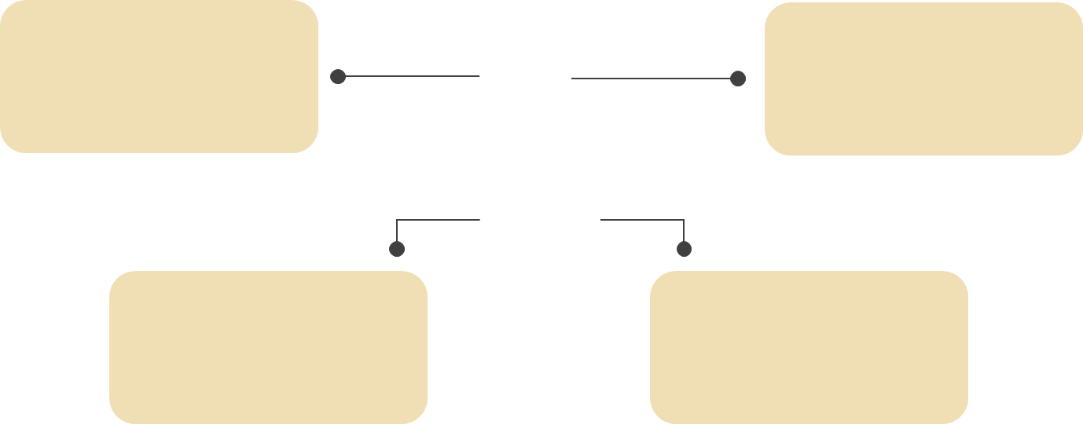

Audit Committee Responsibilities
Audit planning
Approving the scope and methodology of upcoming audits
Review
Periodically reviewing audit reports and findings
Accountability Holds departments or individuals responsible for compliance or security issues.
Oversight
Ensuring that corrective actions are implemented
Notes:
Responsibilities of the audit committee often include the following:
Audit planning: Approving the scope and methodology of upcoming audits
Review: Periodically reviewing audit reports and findings
Oversight: Ensuring that corrective actions are implemented
Accountability: Holding relevant departments or individuals accountable for lapses in compliance or security

Slide 210
Audit Strategy
A clear set of goals should be established.
The scope of the audit should be determined in coordination with business unit managers.
The business unit managers should be included early in the audit planning process and should be engaged throughout the audit life cycle.
Audit strategies:
Audit can be driven by the following factors:
Compliance requirements
Significant changes to the architecture
New developments in the threat the organization is facing
Notes:
Trainer Notes:
Audit strategies:
A clear set of goals should be established.
The scope of the audit should be determined in coordination with business unit managers.
The business unit managers should be included early in the audit planning process and should be engaged throughout the audit life cycle.
Audit can be driven by the following factors:
Compliance requirements
Significant changes to the architecture
New developments in the threat the organization is facing

Slide 211
Audit Planning
It is an important activity for both internal and external audits.
Gain an understanding of the clients and their business
Establish priorities
Determine an audit strategy
Determine the type of evidence to collect based on the risk levels
Determine the skills required to examine and evaluate processes and information systems
Schedule with the client to coordinate activities
An audit plan is a project plan that will help the auditor to:
Source: https://www.schools.utah.gov/file/1e864d3a-9cd5-4933-a2f2-5d6e2a4e4535
Notes:
Source: https://www.schools.utah.gov/file/1e864d3a-9cd5-4933-a2f2-5d6e2a4e4535
Trainer Notes:
Audit planning is an important activity for both internal and external audits.
An audit plan is a project plan that will help the auditor to:
Gain an understanding of the clients and their business.
Establish priorities
Determine an audit strategy
Determine the type of evidence to collect, based on the risk levels
Determine the skills required to examine and evaluate processes and information systems.
Schedule with the client to coordinate activities.

Slide 212
Audit Process
The audit process typically happens as described below:
Involving stakeholders
Bring in business unit managers at the earliest stage possible
Ensure the business needs are identified and addressed
Audit team
Choose the right audit team
Choose whether the team will consist of internal or external personnel depending on the goals, scope, budget, and available expertise
01
03
Goal
Determine the goal of the audit
Scope
Determine the scope of the assessment
02
04
Notes:
Trainer Notes:
Explain the audit process given on the slide.

Slide 213
Audit Process
05
07
Communicate
Communicate with the right leaders in order to achieve and sustain a strong security posture
Conduct the audit
Stick to the plan and document deviations
Plan the audit
Ensure all goals are met on time and are in the budget
Documentation
Document the results
Documentation should start at the beginning of the planning process and continue all the way to the results
06
08
Notes:
Trainer Notes:
Explain the audit process given on the slide.

Slide 214
Elements of a Finding
The results of the audit have five elements in them, namely:
Effect
The difference between and significance of the condition and the criteria
Recommendation
Action that must be taken to correct the cause
04
05
Criteria
Standards used to measure the activity or performance of the auditee
Cause
Explanation of why a problem occurred
02
03
Condition
Statement that describes the results of the audit
01
Notes:
Trainer Notes:
The results of the audit are reported formally to the organization as a series of finding. Five attributes of an audit finding are:
Condition: a statement that describes the results of the audit
Criteria: standards used to measure the activity or performance of the auditee
Cause: explanation of why a problem occurred
Effect: the difference between and significance of the condition and the criteria
Recommendation: action that must be taken to correct the cause

Slide 215
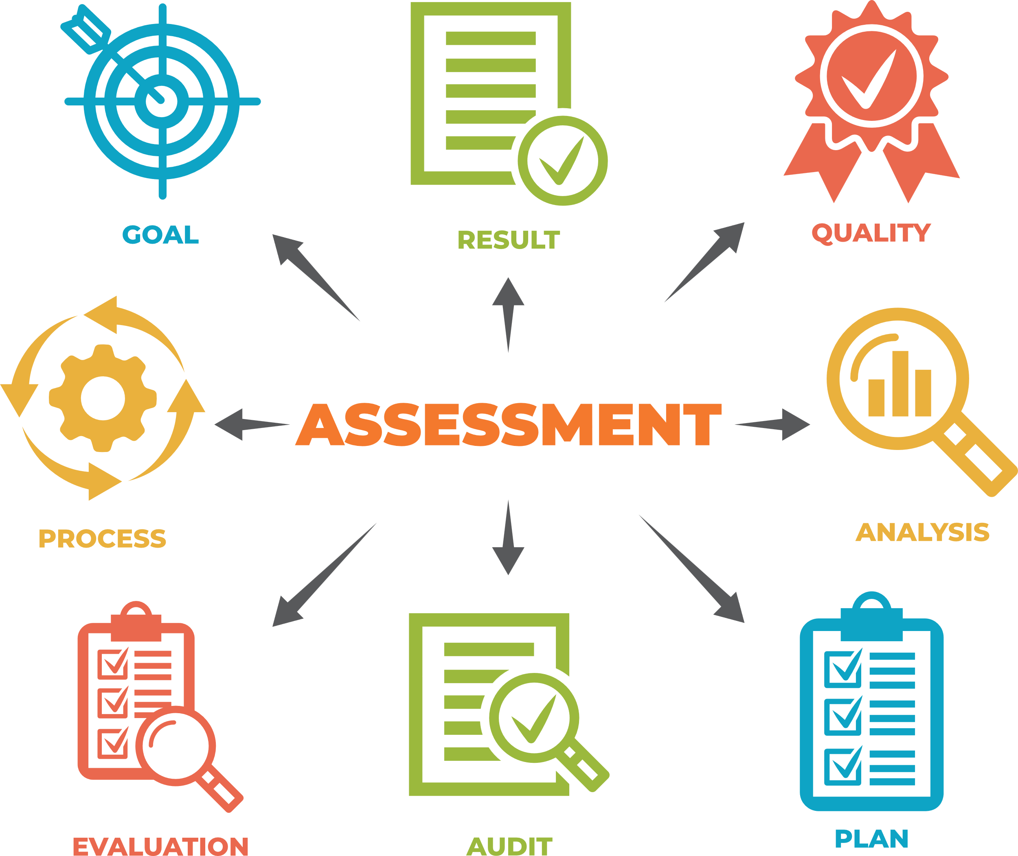
Assessment Report
The assessment report should document the process followed, observations, evidence, findings, conclusions, and recommendations.
The assessment report should be presented to relevant levels of senior management.
The exact format of the report will vary by organization.
The levels of details presented will vary by various audiences.
The report should contain sufficient evidence to support the findings.
The audit artifacts collected during the assessment must be protected from alteration or inappropriate disclosure.
Notes:
Trainer Notes:
The assessment report should document the process followed, observations, evidence, findings, conclusions, and recommendations.
The assessment report should be presented to relevant levels of senior management.
The exact format of the report will vary by organization.
The levels of details presented will vary by various audiences. The senior management may not be able to understand or may not have the time to understand the
technical details.
The report should contain sufficient evidence to support the findings.
The audit artifacts collected during the assessment must be protected from alteration or inappropriate disclosure. The artifacts may contain PHI/PII/Intellectual Property.
These artifacts will be useful for future audits

Slide 216
Remediation
Remediation in the context of auditing refers to the process of correcting identified deficiencies or non-conformities to meet audit standards and requirements. It's a critical step in ensuring ongoing compliance and mitigating risks
The internal assessment results may identify areas where corrective actions or improvement is warranted.
The timetable for remediation of the audit findings should be agreed upon.
Issues identified should be prioritized and fixed during the assessment.
Internal assessment should be subject to continual process improvement.
Plan of Action and Milestones (POAM) is a document that identifies tasks for remediation. It details resources required to accomplish the elements of the plan, any milestones in meeting the tasks, and scheduled completion dates for the milestones.
Notes:
Trainer Notes:
Remediation in the context of auditing refers to the process of correcting identified deficiencies or non-conformities to meet audit standards and requirements. It's a critical step in ensuring ongoing compliance and mitigating risks
The results of internal assessment may identify areas where corrective actions or improvement is warranted.
The timetable for remediation of the audit findings should be agreed upon.
Issues identified should be prioritized and fixed during the assessment.
Internal assessment should be subject to continual process improvement.
Plan of Action and Milestones (POAM) is a document that identifies tasks for remediation. It details resources required to accomplish the elements of the plan, any milestones in meeting the tasks, and scheduled completion dates for the milestones.

Slide 217
Phishing

Slide 218

Phishing
Phishing is a cybercrime where attackers obtain sensitive information by pretending to be
trustworthy entities.
It is a form of social engineering that often involves misleading emails, messages, or websites.
It involves distributing phishing messages to many targets in a campaign.
It varies in complexity and scale, from simple email blasts to highly targeted attacks.
It aims to compromise as many accounts or systems as possible.
Notes:
Phishing is a cybercrime where attackers try to obtain sensitive information by pretending to be trustworthy entities.
It's a form of social engineering that often involves misleading emails, messages, or websites.
A phishing campaign is when attackers distribute phishing messages to many targets, varying in complexity and scale, from simple email blasts to highly targeted attacks.
The goal is to compromise as many accounts or systems as possible.

Slide 219





Types of Phishing
The different types of phishing techniques include:
Spear phishing is a scam where the attacker uses data to make an individual target more likely to be tricked.
Whaling is a spear phishing attack targeting upper management in an organization.
Vishing is a phishing attack conducted through a voice channel.
Smishing uses text messages (SMS) as the attack vector.
Notes:
There are many types of phishing to be aware of:
• Spear phishing—a phishing scam in which the attacker has information that makes a specific target more likely to be duped by the attack. Each phishing message is customized to a particular target consumer. For example, the attacker may know the name of a document that the target is editing and send a malicious copy, or the phishing email may indicate that the attacker knows the recipient's full name, job title, phone number, or other information that help reassure the target that the communication is genuine.
• Whaling—a spear phishing assault aimed directly at the organization's upper management (CEOs and other "big fish"). Because of their inability to learn simple security protocols, upper management could be more vulnerable to ordinary phishing attacks.
• Vishing is a phishing attack that uses a speech channel (such as a phone or VoIP). For example, targets may be contacted by someone claiming to be from their bank, asking them to confirm a recent credit card transaction and requesting their security information. It is much more difficult to reject a phone call request than it is to refuse an email request.
Smishing this refers to using simple message service (SMS) text communications as the vector.

Slide 220





Indicators of Phishing
Several Indicators of Phishing to look out for
Mismatched URLs
Poor grammar and spelling
Requests for sensitive information
Unsolicited attachments
Too good to
be true
Notes:
Mismatched URLs: The hyperlink text may say one thing, but hovering over it reveals a different URL.
Poor grammar and spelling: Official communications are usually well written. Look out for errors in the text.
Requests for sensitive information: Legitimate organizations will never ask for sensitive information via email.
Unsolicited attachments: Be wary of unexpected attachments, as they may contain malware.
Too good to be true: Offers that seem too good to be true usually are.

Slide 221





Process to Counter Phishing
Isolate the threat: If possible, quarantine the email message to prevent further interaction with other employees
Analyze the content: Examine the message for phishing indicators and verify its authenticity.
Notify IT security: Report the incident to the IT security team for further analysis and action
Make users aware: Inform the reporting user and, if necessary, the entire organization about the incident to raise awareness.
Update security measures: Based on the findings, update security protocols, filters, and training to guard against similar future attacks
Notes:
Step 1.Isolate the threat: If possible, quarantine the email message to prevent further interaction with other employees.
Step 2.Analyze the content: Examine the message for any phishing indicators and verify its authenticity.
Step 3.Notify IT security: Report the incident to the IT security team for further analysis and action.
Step 4.Make users aware: Inform the reporting user and, if necessary, the entire organization about the incident to raise awareness and prevent further clicks.
Step 5.Update security measures: Based on the findings, update security protocols, filters, and training to guard against similar future attacks

Slide 222

Countermeasure for Phishing
Do not click on links or download attachments
Report the phishing attempt immediately
Educate yourself and others
Change passwords
Notes:
Do not click on links or download attachments: Avoid interacting with any suspicious elements within the message, including links or attachments.
Report the phishing attempt immediately: Notify your organization’s IT department or the appropriate authorities about the phishing attempt. Reporting helps them take action and potentially prevent future attacks.
Educate yourself and others: Share your experience and knowledge of phishing with friends, family, and colleagues. Awareness is a vital tool in the fight against cybercrime.
Change passwords: If you believe your credentials may have been compromised, change your passwords immediately, using strong, unique passwords for each account.

Slide 223
Anomalous Behavior Recognition

Slide 224

Anomalous Behavior Recognition
Anomalous behavior recognition identifies patterns or activities that deviate significantly from normal or expected behavior.
It indicates a security threat, such as unauthorized access or data exfiltration.
It helps in preemptive threat detection by recognizing anomalous behavior.
It ensures timely incident response.
Notes:
Anomalous behavior recognition is the process of identifying patterns or activities that deviate significantly from normal or expected behavior.
It’s critical to many security systems, fraud detection systems, and anomaly detection applications.
Such deviation from regular activity could indicate a security threat, such as unauthorized access or data exfiltration.
Recognizing anomalous behaviour is vital for preemptive threat detection and timely incident response

Slide 225
Types of Anomalous behavior recognitions
Risky
Unexpected
Unintentional
Risky behavior involves actions that pose a higher risk or potential harm to a system or organization, such as sharing login credentials, downloading suspicious files, or ignoring security warnings.
Unexpected behavior includes actions or activities that deviate from established norms or historical patterns, such as a user suddenly trying to access sensitive data or excessive server memory consumption.
Unintentional behavior involves human error or accidents, such as misconfigurations, accidental data leaks or social engineering attacks.
Notes:
Types of ABR
Risky: Risky behavior represents actions that, while not necessarily malicious, carry a heightened level of risk or potential harm to a system or organization. This can include actions such as granting excessive permissions, sharing login credentials, downloading suspicious files, or ignoring security warnings.
Unexpected: Unexpected behavior is characterized by actions or activities that deviate from established norms or historical patterns. It encompasses actions that may not align with a user’s typical behavior or system operation—for example, a user suddenly trying to access sensitive data or excessive server memory consumption.
Unintentional: Unintentional behavior involves actions that occur due to human error or accidents. This can encompass misconfigurations, accidental data leaks, or actions taken by users who have been tricked by social engineering attacks. Unintentional behavior can be caused by a lack of awareness or insufficient training.

Slide 226




How ABR Works
Data Collection: Gathering relevant data points, such as user behavior, system logs, network traffic, or sensor readings
Establishing Baseline: Defining normal behavior patterns based on historical data and statistical analysis.
Anomaly Detection: Identifying data points or patterns that significantly deviate from the established baseline
Alert Generation: Triggering alerts or notifications when anomalous behavior is detected.
Investigation: Analyzing the detected anomalies to determine if they pose a threat or require further investigation.
Notes:
Data Collection: Gathering relevant data points, such as user behavior, system logs, network traffic, or sensor readings.
Establishing Baseline: Defining normal behavior patterns based on historical data and statistical analysis.
Anomaly Detection: Identifying data points or patterns that significantly deviate from the established baseline.
Alert Generation: Triggering alerts or notifications when anomalous behavior is detected.
Investigation: Analyzing the detected anomalies to determine if they pose a threat or require further investigation.

Slide 227
Applications of Anomalous Behavior Recognition
IDEAS
Cyber Security
Intrusion Detection System
Fraud Detection
Identifying suspicious network traffic, unauthorized access attempts, or insider threats.
Detecting fraudulent transactions, credit card fraud, or insurance claims..
Identifying unauthorized access to computer systems or networks.
Network Security
Industrial Control System
Financial Markets
Detecting anomalies in network traffic patterns to identify potential attacks.
Monitoring equipment behavior for signs of malfunction or cyberattacks.
Identifying unusual trading patterns or market anomalies.
Notes:
Applications of ABR
Cybersecurity: Identifying suspicious network traffic, unauthorized access attempts, or insider threats.
Fraud Detection: Detecting fraudulent transactions, credit card fraud, or insurance claims.
Intrusion Detection Systems (IDS): Identifying unauthorized access to computer systems or networks.
Network Security: Detecting anomalies in network traffic patterns to identify potential attacks.
Industrial Control Systems (ICS): Monitoring equipment behavior for signs of malfunction or cyber attacks.
Financial Markets: Identifying unusual trading patterns or market anomalies.

Slide 228
Techniques for Anomalous Behavior Recognition
Statistical Methods
Machine Learning
Using statistical analysis to identify outliers in data.
Applying algorithms to learn standard behavior patterns and detect deviations.
Data Mining
Rule Based System
Discovering hidden patterns in large datasets to identify anomalies.
Defining specific rules to detect anomalies based on predefined conditions.

Slide 229
Challenges with ABR
Determining what constitutes normal behavior can be complex, especially in dynamic environments.
False positives and false negatives
Balancing sensitivity and specificity to avoid generating too many false alarms or missing critical anomalies.
Defining normal behavior
Adapting to new and emerging threats that may exhibit previously unseen behavior patterns.
Evolving threats
Data volume
Processing and analyzing large volumes of data can be computationally intensive.
Notes:
Challenges in Anomalous Behavior Recognition:
Defining Normal Behavior: Determining what constitutes normal behavior can be complex, especially in dynamic environments.
False Positives and Negatives: Balancing sensitivity and specificity to avoid generating too many false alarms or missing critical anomalies.
Evolving Threats: Adapting to new and emerging threats that may exhibit previously unseen behavior patterns.
Data Volume: Processing and analyzing large volumes of data can be computationally intensive

Slide 230
User Guidance and Training

Slide 231

User Guidance and Training
These are crucial elements of a strong cybersecurity strategy.
Empowering employees with knowledge and awareness allows organizations to significantly reduce the risk of cyberattacks by enabling active participation in organizational security.
These elements include policies or handbooks, situational awareness, insider threat management, password management, removable media and cable security, social engineering awareness, operational security, and guidelines for hybrid or remote working roles.
Notes:
User guidance and training are crucial elements of a strong cybersecurity strategy.
Empowering employees with knowledge and awareness allows organizations to significantly reduce the risk of cyberattacks.
User guidance and training empower employees to participate actively in organizational security.
These elements include policy/handbooks, situational awareness, insider threats, password management, removable media and cables, social engineering, operational security, and working in a hybrid/remote working role

Slide 232
Tasks During User Guidance and Training
Policy handbooks
Situational awareness
Clear and comprehensive policies and handbooks are essential for effective user awareness training.
These may include standard operating procedures, acceptable use policies, security protocols, or consequences of non-compliance.
This involves identifying threats, understanding consequences, and making informed decisions to minimize risks.
Regular training boosts users' ability to maintain situational awareness and avoid cyberattacks
Notes:
Elements of User Training
Policy/handbooks: Clear and comprehensive policies and handbooks are an essential part of user awareness training. These might include standard operating procedures, acceptable use policies, security protocols, or the consequences of non-compliance. Effective policies should be regularly reviewed, updated, and communicated to all staff to ensure ongoing adherence to the policy.
Situational awareness: Situational awareness is about identifying potential threats and vulnerabilities, understanding the consequences of actions, and making informed decisions to minimize risks. Consistent training can improve users’ capacity to maintain a heightened state of situational awareness and equip them with the skills necessary to avoid cyberattacks.

Slide 233
Tasks During User Guidance and Training
Insider threats
Password management
Detecting and addressing insider threats can be challenging.
Training should cover types of insider threats and foster a culture of trust and vigilance to prepare employees to identify and report suspicious behavior.
Password management involves using strong, unique passwords for different services and applications to ensure ongoing security.
Strong passwords typically include uppercase and lowercase letters, numbers, and special characters.
Notes:
Elements of User Training
Insider threat: Insider threats can be among the most challenging to detect and mitigate. User training should include education about the types of insider threats that they may encounter, such as malicious insiders and unwitting accomplices. By fostering a culture of trust and vigilance, organizations can better prepare their workforce to identify and report suspicious behavior.
Password Management-Password management involves using strong, unique passwords for different services and applications to ensure ongoing security. Strong passwords typically include uppercase and lowercase letters, numbers, and special characters.

Slide 234
Tasks During User Guidance and Training
Social engineering
Removable media and cables
Social engineering attacks prey on human psychology.
Training should educate users about common social engineering tactics, such as phishing emails, smishing, or vishing (voice phishing over the phone).
Simulated phishing exercises help users develop resistance to deceptive strategies.
Removable media and cables pose a potential security risk, as these can be vectors for malware or data leakage.
User guidance should emphasize scanning removable media for threats and avoiding unknown devices, such as USB cables left on your desk or sent unexpectedly through the mail.
Notes:
Elements of User Training
Social Engineering-Social engineering attacks prey on human psychology. Training should educate users about common social engineering tactics, such as phishing emails, smishing, or vishing (voice phishing over the phone). Simulated phishing exercises can help users develop resistance to these deceptive strategies
Removable media and Cables-Removable media and cables pose a potential security risk, as these can be vectors for malware or data leakage. User guidance should emphasise the importance of scanning removable media for threats and avoiding unknown devices, such as USB cables left on your desk or sent unexpectedly through the post.

Slide 235
Tasks During User Guidance and Training
Operational security (OPSEC)
Hybrid/Remote work environment
Operational security involves securing day-to-day activities, including communication, data encryption, and incident reporting to protect sensitive information from unauthorized access.
Training should cover best practices for maintaining OPSEC in diverse work environments.
The shift to hybrid and remote work setups has introduced several new security challenges for organizations.
Providing thorough training for employees to address challenges, such as securing home networks and using public Wi-Fi for work tasks, is important.
Notes:
Operational Security-Operational security involves securing day-to-day activities, such as communication, data encryption, and incident reporting to protect sensitive information from unauthorized access. Training should cover best practices for maintaining OpSec in diverse work environments.
Hybrid/Remote work environment
The shift to hybrid and remote work setups has introduced several new security challenges for organizations. It's important to provide thorough training for employees to address these challenges, such as securing home networks and using public Wi-Fi for work tasks.

Slide 236
Tasks During User Guidance and Training
Virtual private networks (VPNs)
These are another crucial element in remote work security.
A VPN encrypts the Internet connection, making it more difficult for attackers to intercept data.
Employees should be trained to set up and use a VPN to ensure a secure connection to the organization’s network while working remotely.
Notes:
Virtual Private Network-Virtual private networks (VPNs) are another crucial element in remote work security. A VPN encrypts the Internet connection, making it more difficult for attackers to intercept data. Employees should be trained to set up and use a VPN while working remotely to ensure a secure connection to the organization’s network

Slide 237
Reporting and Monitoring

Slide 238
Reporting and Monitoring
These involve creating detailed vulnerability reports and continuously tracking security measures to promptly detect and address new threats, maintaining a secure and compliant infrastructure.
This feature involves developing and implementing a plan to respond quickly and effectively to security incidents.
Notes:
Organizations should have reporting and monitoring processes for security training.
This helps assess effectiveness, track training completion, and ensure employee engagement in security measures.
There needs to be a well-defined plan in place to help you create and evaluate the training program, ensuring that it achieves its intended goals

Slide 239

Security Awareness Practice framework
Goals/Needs
Monitor
Develop
Feedback
Deliver

Slide 240
Security Awareness Practice framework
Goals/Needs
The initial phase of a new training course requires key stakeholders to review specific areas of security awareness training to be addressed in each session
Develop
A decision is made about the type of training material to be used, such as classroom handouts, lab exercises, or online simulations.
Delivery
Stakeholders must decide on the delivery method - virtual via Zoom, classroom-based with handouts and lectures, or computer-based training using simulations or gamification.
Feedback
The feedback stage comes after the training has been completed. Participants will evaluate the course. Did it meet the goals? What adjustments need to be made?
Monitor
Tracking completion rates for security awareness training is essential during this phase, serving as a key measure of employee engagement and training compliance.
Notes:
Goals/Needs-The initial phase of a new training course requires key stakeholders to review specific areas of security awareness training to be addressed in each session
Develop-A decision is made about the type of training material to be used, such as classroom handouts, lab exercises, or online simulations.
Delivery-Stakeholders must decide on the delivery method - virtual via Zoom, classroom-based with handouts and lectures, or computer-based training using simulations or gamification.
Feedback-The feedback stage comes after the training has been completed. Participants will evaluate the course. Did it meet the goals? What adjustments need to be made?
Monitor-Tracking completion rates for security awareness training is essential during this phase, serving as a key measure of employee engagement and training compliance

Slide 241
Effectiveness of Training
When we deliver security awareness training, we need to measure how effective the training has been.
Measure the effectiveness of cybersecurity training is crucial to ensure that employees are equipped to protect the organization.
By carefully evaluating the effectiveness of cybersecurity training and making necessary adjustments, organizations can significantly enhance their overall security posture.
Notes:
When we deliver security awareness training, we need to measure how effective the training has been.
Measuring the effectiveness of cybersecurity training is crucial to ensure that employees are equipped to protect the organisation.
By carefully evaluating the effectiveness of cybersecurity training and making necessary adjustments, organizations can significantly enhance their overall security posture.

Slide 242
Types of Effectiveness
Initial Assessments
Recurring Assessments
We can measure the initial effectiveness of the security awareness training by reviewing business operations. For example, how many times an account was breached via a phishing scam or other attack, and whether and to what extent that number has dropped following the training?
We need to determine if there has been an increase in security incidents six months after the initial training, possibly due to user complacency. If there is, we'll need to re-conduct security awareness training for
end users.
Notes:
Initial: We can measure the initial effectiveness of the security awareness training by reviewing business operations—for example, how many times an account was breached via a phishing scam or other attack and whether and to what extent that number has dropped following the training.
Recurring: We need to assess whether, six months following our initial training, there’s an increase in security incidents, possibly due to users becoming complacent. Should this be the case, it will be necessary to re-conduct the security awareness training to reeducate end users.

Slide 243

Development of Training
During development, it's important to identify objectives, define scope, and set measurable goals.
Create a detailed project plan, identify stakeholders, and define their roles.
Develop training materials, simulations, and monitoring mechanisms tailored to the organization's cybersecurity needs.
Notes:
During development, it's important to identify objectives, define scope, and set measurable goals. Create a detailed project plan, identify stakeholders, and define their roles.Develop training materials, simulations, and monitoring mechanisms tailored to the organization's cybersecurity needs.

Slide 244
Execution of Training
Security awareness training materials are critical, but successful delivery is equally important.
Delivery turns knowledge into action, fostering a culture of security.
Key components include:
1. Implementing training modules
2. Utilizing monitoring tools
3. Performing simulated attacks
Real-time monitoring is vital for:
1. Tracking user engagement
2. Recording incident reports
3. Measuring the success rates of simulated attacks
Any identified gaps should be promptly addressed, and the program adjusted as needed.
Notes:
Creating security awareness training materials is critical, but successful delivery is equally important. Delivery turns knowledge into action, fostering a culture of security. This involves rolling out training modules, using monitoring tools, and conducting simulated attacks. Real-time monitoring is essential, tracking user engagement, incident reports, and simulated attack success rates. Any identified gaps should be promptly addressed, and the program adjusted as needed.

Slide 245
Effective Methods for Implementing Training
Customized delivery methods
Launch with enthusiasm
Phased rollout
To ensure effective execution, start with the right delivery methods. Consider your workforce's preferences. Some may prefer in-person training, others online modules, or a mix of both. Customize your approach to maximize engagement.
Launch security awareness training with enthusiasm by highlighting cybersecurity's importance and benefits and involve senior leadership to show their commitment to the entire workforce.
Implement a phased approach to training by starting with foundational topics and gradually introducing advanced concepts to prevent overwhelming employees and allow for progressive knowledge building.
Notes:
Customized Delivery Methods-Effective execution begins with the right delivery methods. Consider your workforce’s preferences and needs. While some employees may respond well to in-person training, others may prefer online modules or a combination of both. Tailor your approach to ensure maximum engagement.
Launch with enthusiasm-The launch of your security awareness training should generate enthusiasm. Create a buzz within the organization by emphasizing the importance of cybersecurity and the benefits of the training, and engage senior leadership to communicate their commitment to security, setting the tone for the entire workforce.
Phased Rollout-Consider a phased rollout of the training program. Start with foundational topics and gradually introduce more advanced concepts. This approach helps you avoid overwhelming employees and allows them to build on their knowledge progressively.

Slide 246
Effective Methods for Implementing Training
Interactive workshops
Scenario based learning
Gamification
Incorporate interactive workshops or hands-on activities into your training execution. These sessions provide employees with practical experience and an opportunity to apply their knowledge in real-world scenarios.
Implement scenario-based learning exercises that mimic potential security threats. These exercises allow employees to practice identifying and responding to security incidents and build confidence in their abilities.
Gamify the training process by incorporating elements such as quizzes, challenges, and leaderboards. Gamification makes learning enjoyable and competitive, encouraging active participation and knowledge retention.
Notes:
Interactive workshops: Incorporate interactive workshops or hands-on activities into your training execution. These sessions provide employees with practical experience and an opportunity to apply their knowledge in real-world scenarios.
Scenario-based learning: Implement scenario-based learning exercises that mimic potential security threats. These exercises allow employees to practice identifying and responding to security incidents and build confidence in their abilities.
Gamification: Gamify the training process by incorporating elements such as quizzes, challenges, and leaderboards. Gamification makes learning enjoyable and competitive, encouraging active participation and knowledge retention.

Slide 247
The elements of effective security governance enhance organizational security protocols.
The elements of the risk management process mitigate potential risks effectively.
The processes associated with third-party risk assessment and management ensure comprehensive security coverage.
Effective security compliance maintain regulatory standards.
Types and purposes of audits and assessments improve overall security measures.
Notes:
Trainer Notes:
Summarize the points given on the slide.

